Slide 1
History of the Ohio Society of
Radiologic Technologists
OSRT Leadership Academy

Slide 2
History of the Ohio Society of Radiologic Technologists
On November 12 and 13, 1938 forty-eight x-ray technicians met in Lima, Ohio and signed an Affiliation Charter of the American Society of X-ray Technicians, thus officially forming the Ohio Society of X-ray Technicians.

Slide 3
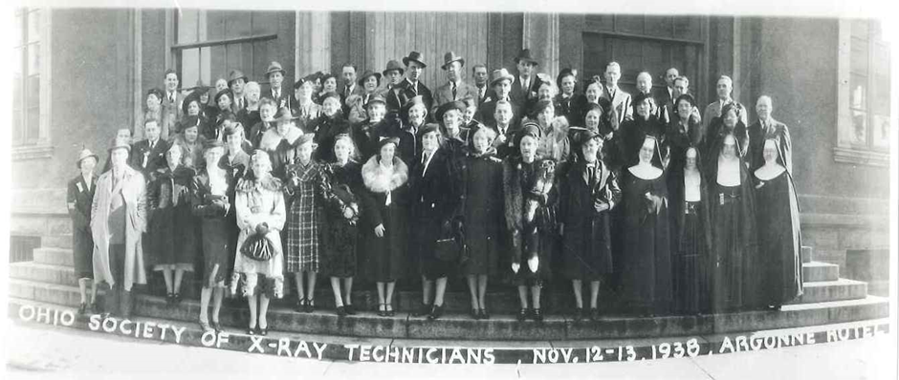
First Annual Meeting
Notes:
The 1938 meeting was considered the first Annual Meeting of the OSXT.
Annual Meetings have been held every year except during the war years of 1943, 1944, and 1945.
On March 2 and 3, 1957, the first Annual Educational Meeting was held in Columbus. That same year, the Annual Business Meeting was moved to the fall.

Slide 4
Changes to the Annual Meeting
1975 Student Quiz Bowl
1995 Education Meeting and Business Meeting combined
One Annual Meeting each spring
Notes:
1975 Student Quiz Bowl competition was initiated as part of the Annual Educational Meeting with teams from Radiologic Technology programs from across the state.
These meetings were also rotated among the cities in Ohio until 1995 when the two meetings were combined.
One meeting is now held each spring, the Annual Meeting of the Ohio Society of Radiologic Technologists to include the Quiz Bowl competition.

Slide 5
OSRT Life Members
Rubygrant Pennell, R.T.
Mary E. Adkins, R.T.
Mildred Jacobi Ridgeway, R.T.
David G. Shields, R.T.
Elizabeth M. Broadhurst, R.T.
Ray L. Berg, R.T.
Roy E. Bell, R.T.
Joan L. Parsons, R.T.
Rose Fitz, R.T.
W. Jay Huston, R.T.
William Thomas, R.T.
Nancy Dome-Hatfield, R.T.
Philip W. Ballinger, R.T.
William Lee Shadle, R.T.
Denise E. Moore, R.T.
Nina K. Kowalczyk, R.T.
Francine Knutson Todd, R.T.
Linnea Hopewell, R.T.
Sheryl Bacon, R.T.
Julie Gill, R.T.
Deborah O’Mellan, R.T.
Angie Arnold, R.T.
Notes:
This is an honor for which the member must be nominated, then unanimously approved by the Board
These individuals are granted comped membership fees and registration fees for the Annual Meetings.

Slide 6
Honorary Members
Laura Kahle, R.T., Cincinnati, OH
Clark Warren, Royal Oak, MI
Mary C. Zarlengo, Wooster, OH
Roland C. McGowan, R.T., Minneapolis, MN
Kenneth Lutz, R.T., West Chester, PA
James Curry, M.D., Mansfield, OH
John Schloss, R.T., Lansdown, PA
Elsie Thomas, Fort Myers, FL
Joseph Fodor III, R.T., FASRT, Mason, OH
Robert Todd, Huron, OH
Fred Vierow, Columbus, OH
Jonathan Mazal, MS, RRA, R.T. (R)
Notes:
Honorary members are those persons who the Society desires to honor because of their demonstrated interest in and/or contributions to the Society. Honorary membership are determined by a unanimous vote of the Board of Directors. Honorary members pay no dues and have all the privileges and obligations of active members except for the right to vote or hold office.

Slide 7
Ohio ASRT Fellows (FASRT)
Roy Bell 1982
Joseph Fodor III 1988
Jack Malott 1988
Philip Ballinger 2003
Nina Kowalczyk 2005
Kevin Rush 2010
Tricia Leggett 2018
Julie Gill 2019
Jonathan Mazal 2019
Notes:
The honorary category of Fellow is bestowed upon members who have made outstanding contributions to the radiologic technology profession and to the ASRT. This category was initiated within the ASRT to honor members who were dedicated to the organization and contributed unselfishly to the profession. The first class of 12 technologists was elevated to Fellow status in 1956. Each Fellow has committed to the advancement of the profession at the district, state, regional, national and international levels.
Phil Ballinger –ASRT Life Member 2002
Nina Kowalczyk—ASRT Life Member 2014

Slide 8
Past Presidents of the OSRT-ASRT
Five Ohio technologists have been President of the American Society of Radiologic Technologists:
Rubygrant Pennell, R.T., Columbus (1954-55)
Wilbur J Huston, R.T., Sandusky (1961-62)
Roland C. McGowan, R.T., Cincinnati (1964-65)
Joan Parsons, R.T., Massillon (1984-85)
Julie Gill, R.T., Ashville (2013-2014)
Notes:
Historically the OSRT has been involved at the national level of the ASRT as shown by the list of the past presidents of the ASRT.
ASRT Affiliate Delegates

Slide 9
Distinguished Honors
Technologist of the Year Award
Past-President Honor Lecture
Previously the Penn-Hu-Mac-Par-Gill Honorary Lecture
Notes:
The invitational Guest Lecture Series was established in 1966. Starting in 1974 the lecture series was given in honor of the OSRT members who were past presidents of the ASRT and was renamed the Penn-Hu-Mac Lecture Series. After the ASRT presidency of Joan Parson’s, the series was renamed the Penn-Hu-Mac-Par Lecture. Again in 2015 the lecture was renamed to the Penn-Hu-Mac-Par-Gill Lecture after Julie Gill’s term ended at the ASRT. Most recently in 2019, the Board approved a name change to the Past-President Honor Lecture.
Any member may nominate the lecturer via written or email communication to the Board of Directors.
Lecturer will be selected by a vote of the Board of Directors three (3) years in advance of lecture date at Post-Annual Board meeting.
The Penn-Hu-Mac-Par-Gill lecture will be presented at the Francine Todd Memorial Honors Banquet.
A “Request for Nominations for Penn-Hu-Mac-Par-Gill Lecturer” will be placed on the website by the Executive Secretary.
Tech of the Year
Any OSRT active member may electronically submit a nominee application.
Eligible nominees must meet this criteria:
Be a current member in good standing with a minimum of at least six years OSRT membership.
Be credentialed and in good standing for at least six years with: ARRT, ARDMS, or NMTCB.
Have served the OSRT as an officer, editor, committee chair or committee member.
Must be present at the OSRT Annual Meeting Honors Banquet.
Note: Previous winners may be nominated.
To nominate a qualified candidate: Complete and submit the electronic application form by January 15. The membership will vote on nominees online. The winner will be notified prior to the Annual Meeting.

Slide 10
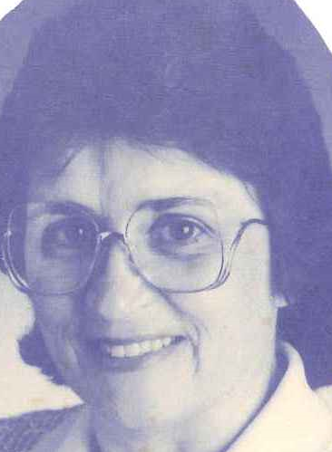
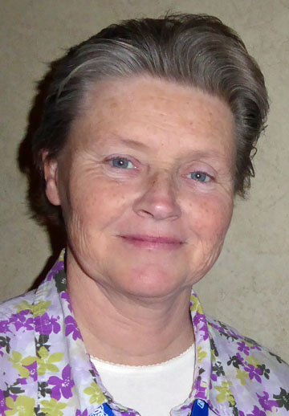
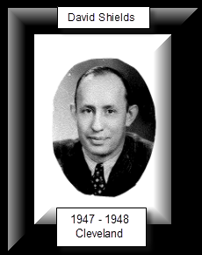
Historically speaking…
David Shields, R.T.
Nancy Dome-Hatfield, R.T.
Angie Arnold, R.T.
Notes:
OSRT formally published its history thanks to the efforts of historian and long time member, David Shields, R.T. Mr. Shields was one of the original forty-eight founding members of OSRT. Thanks to his efforts, OSRT has preserved its history in a formally published document. For information on the publication, contact current OSRT Historian, Angie Arnold, R.T.(R). A huge debt of gratitude is extended to Nancy Dome-Hatfield, RT(T) who has resigned this position after 29 years.

Slide 11
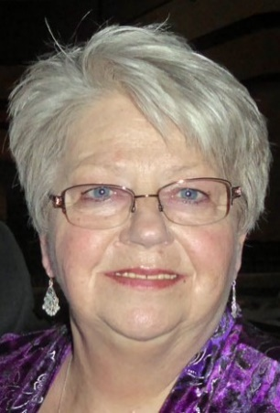
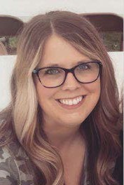
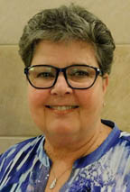
Publications
Cardinal Rays
Website
Sheryl Bacon, R.T., Co-editor
Whitney Reese, R.T., Co-editor
Denise Moore, R.T., Webmaster
Notes:
The Ohio Society of Radiologic Technologists publishes the Cardinal Rays, a newsletter distributed bi-monthly to members. In addition, the OSRT maintains an active web-site with current information about the society and the profession.

Slide 12
OSRT Staff
Jay Ball, R.T., Financial Manager
Lauren Huffman, R.T., Executive Secretary
Sheryl Bacon, R.T., Executive Secretary Advisor

Slide 13
History of the OSRT Education & Research Foundation (OSRTERF)
2007 Mariner Project
Promotion of strategies to help maintain a strong organization
Recommendation offered by ASRT focused on the need for OSRT to develop a distinct Foundation, separate from OSRT’s business organization
Notes:
In 2007 OSRT hosted a board meeting attended by two representatives of the American Society of Radiologic Technologists (ASRT). The ASRT developed and sponsored the “Mariner Project” designed to support State Affiliate Societies in their efforts to promote strategies to help maintain a strong organization. One strong suggestion offered by ASRT focused on the need for OSRT to develop a distinct Foundation, separate from OSRT’s business organization.
Now let’s discuss the direction the OSRT went with separation into two organizations and the discussion a 501(c)(3) and a 501(c)(6)

Slide 14
Necessity for Two Separate Organizations
501(c)(3)
Most common type of tax-exempt nonprofit organization, exempt from federal income tax if its activities have the following purposes: charitable, religious, educational, scientific, literary…
Must advance a charitable purpose
Forbidden Activities
Net earnings to benefit a private individuals
Political activity - Campaign funds, Political Action Committee (PAC), candidate endorsements
Notes:
At that time the OSRT was officially recognized by the IRS as a 501(c)(3) non-profit organization. By law, this IRS designation limited the OSRT in its ability to support politically active, legislative initiatives (lobbying efforts). In other words the Society needed to separate its business interests from its legislative efforts

Slide 15
Necessity for Two Separate Organizations
501(c)(6)
Members share a common business interest
Tax exempt business league, chamber of commerce, boards of trade, and similar organizations
Forbidden Activities
Net earnings to benefit private individuals
Regular engagement in a business for profit

Slide 16
Commonalities
Exempt from federal income tax and sometimes state and local tax
Both file an IRS form 990
No inside member may gain unreasonable benefits to detriment of organization
Political activity rules
Unrelated business income (UBI) rules
Notes:
Each state has its own tax code. UBI rules require nonprofit to report income earned from unrelated or taxable income for federal income tax purposes. This is why OSRT does not sell t-shirts for annual meeting.

Slide 17
Differences
Contributions to 501(c)(3) are tax deductible
501(c)(3) supported by contributions and grants; 501(c)(6) dependent upon member revenue

Slide 18
Breakin' Up Is Hard To Do
Establishment of two Organizational Entities
Business operations-501(c)(6) organization
Philanthropic-501(c)(3) organization
Notes:
In December, 2007, the OSRT Board of Directors was advised by the OSRT attorney of the requirements to legally establish two organizational entities; one for its business operations and one for its philanthropic operations. The Ohio Society of Radiologic Technologists Foundation was formally recognized as the 501(c)(3) organization, the humanitarian arm of OSRT and, the business arm of the Ohio Society of Radiologic Technologists was formally recognized as a 501(c)(6) non-profit organization.

Slide 19
Unanimous Board approval to formally separate into two organizations effective Feb. 1, 2008
Final bylaws for two separate organizations were approved by the OSRT membership on September 30, 2008.
Notes:
Following these actions, the OSRT Board unanimously approved a resolution to formally separate the two organizations. Initially, the first resolution was presented to the OSRT Board and became effective on February 1, 2008.
On August 12, 2008, the Board of Directors of the Foundation signed a resolution adopting bylaws and approved by the OSRT membership. Following this action, the OSRT was advised to clarify some language of the initial resolution with a subsequent vote of approval by the OSRT Board of Directors. On September 30, 2008, the OSRT Board voted and unanimously approved the substitute resolution

Slide 20
The resolution separating the two organizations was finalized when the membership voted and unanimously approved the resolution on November 30, 2008.
Notes:
The Board is responsible for setting direction and strategy for the association. The Board also has financial responsibility for the association and, most importantly, is responsible for ensuring that the organization meets its mission.

Slide 21
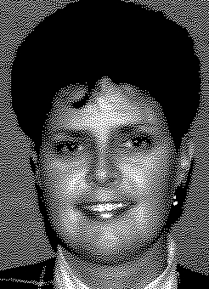
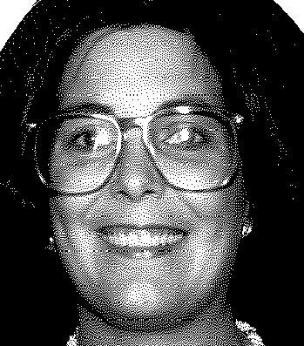
Our past is a part of our future!
This concludes
your history lesson!

