Slide 1
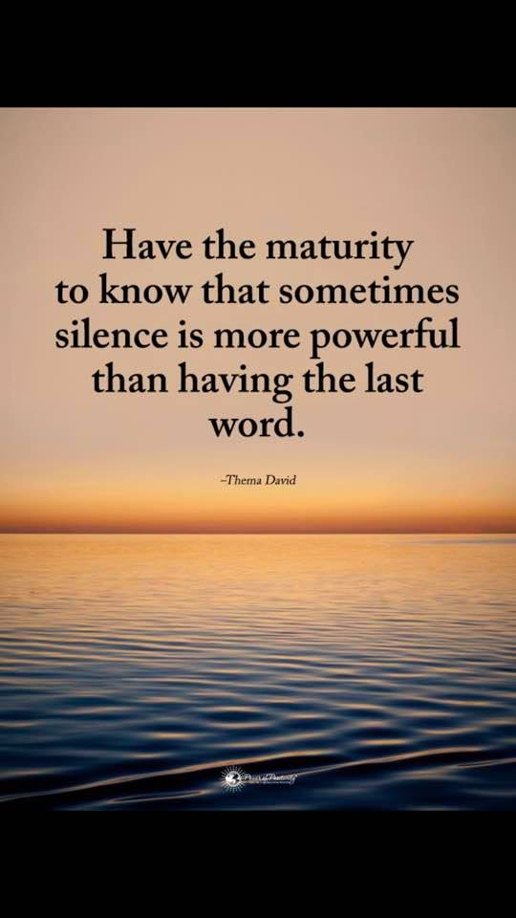
Communication and Transparency

Slide 2
Internal Board Communication
All communication among and between board members should be done to:
Learn more about an issue or item.
Provide information not previously discussed.
Advocate for or against an issue or item with reason.
Question assumptions: playing the devil’s advocate.

Slide 3
Internal Board Communication
It is okay, actually very healthy, to bring diverse viewpoints to the table.
Debate is helpful in making diverse views of the membership known. Debate can and should be expected. However, debate must be constructive and respectful.
“Help me to understand…”
“Can you explain that a little further for me?”

Slide 4
Internal Board Communication
According to Board Forward®, “While it is perfectly acceptable to respectfully express a dissenting opinion at the board table, as a board you have the responsibility to speak to the members of your association with a common voice and vision. Once a board decision is made — regardless of your personal point of view — you have an obligation to publicly support it.”

Slide 5
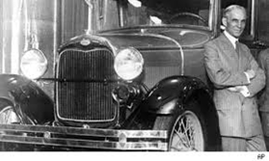
External Board Communication
Board members represent those that elected them to serve so you must communicate with them to find out their concerns, thoughts, and desires.
Henry Ford said, “Coming together is a beginning; keeping together is progress; working together is success.”

Slide 6
External Board Communication
According to Board Forward®, associations should
enable members to collaborate in-person and online;
foster a sense of community among members;
enhance existing knowledge with networking, education and sharing of best practices; and
ask members what they need and then deliver those needs.

Slide 7
What is Transparency?
Transparency is a condition of freedom of information, participation and accountability via open communication.

Slide 8
Transparency in an Organization
Trust is built through transparency:
Finances
Personnel
Issues of interest
Important decisions
Motions

Slide 9
Communicating Board Business
The business of the Board is communicated to the membership via email blasts, in the Cardinal Rays President’s column, on the website, and at the Annual Meeting Business Session.
Board members also talk with members to let them know what is happening on a state and national level.

Slide 10
Importance of Effective Communication
Notes:
Laugh here.

Slide 11
Conflict Resolution
Just because you have good interpersonal skills, treat people with respect, and use good manners doesn’t guarantee you’ll get along with every person in every situation
You can count on some interpersonal conflict—it’s a given
https://www.skillsyouneed.com/ips/conflict-resolution.html

Slide 12
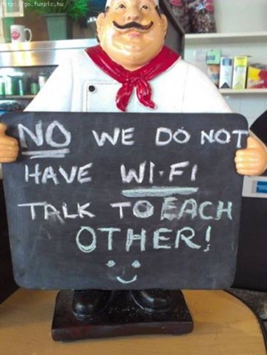
Using Communication Skills to Resolve Conflict
Active listening skills are vital
Don’t just hear the other person talking to you, but listen to them and make sure that you understand what (s)he is saying
When you are speaking, be clear and concise and ask questions to make sure that the other person understood your meaning

Slide 13
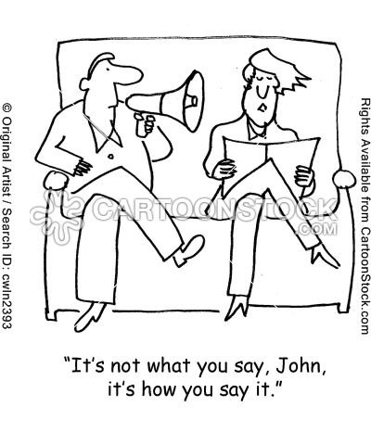
Using Communication Skills to Resolve Conflict
Choose your battles wisely. Decide which conflicts are really worth tackling and which ones you can let go.
Is it an issue that just rubs you the wrong way or is it an issue that you believe is not in the best interest of the membership or profession?
When you decide to confront an issue, make sure that you have all the facts first—complete and accurate information. No assumptions!!

Slide 14
Using Communication Skills to Resolve Conflict
Once you fully understand the other person’s point of view and (s)he understands you, there should be a middle ground where you can compromise and both feel like your needs have been met and that you acted in the best interest of the membership and/or profession.

Slide 15
Top Ten List for Being a Good Board Member
OSRT Top Ten List for Board Members
http://wexfordcoa.org/event/coa-board-directors-meeting/

Slide 16
Let’s Have a Board Meeting
LA faculty will serve as President, Senior Chairperson of the Board and Parliamentarian
2 groups: each group will choose an initiative from our Strategic Plan SWOT analysis to present to the Board for approval
Can we all come to a consensus for an action to be taken by the Board?

