Slide 1
Committee
Structure
Notes:
6th PPT

Slide 2
Committees and Volunteers
Dynamics with committee work
Collaboration with committee work
Notes:
Being on a board is like being in a huddle of quarterbacks. All have leadership qualities, but the primary quarterback is either the President, representing the society while the Senior Chair of the Board represents the OSRT Board.
All committee members and volunteers eventually report to one of these two individuals.

Slide 3
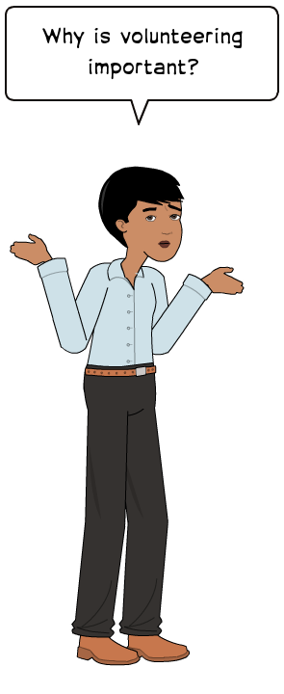

Slide 4
Characteristics Homework
Positive
Negative

Slide 5
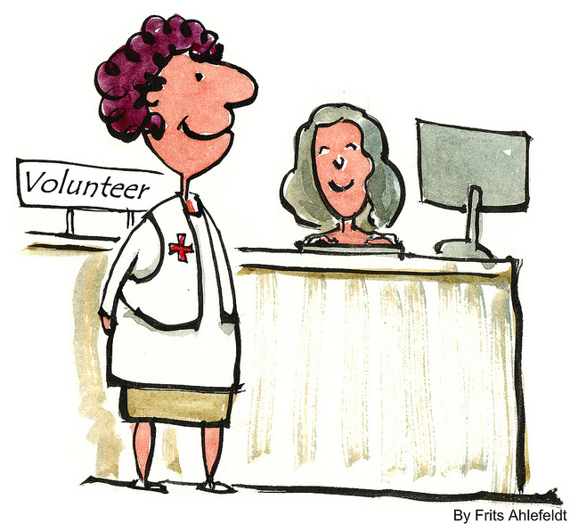
Traits of Amazing Volunteers
Results driven
Passionate professionalism
Collaborative mindset
Make no excuses
Constant champions
Energizers
It’s a match
http://www.forbes.com/sites/michaellindenmayer/2013/06/03/7-traits-of-amazing-volunteers/
Notes:
They want their causes to generate major positive impact. This means implementing great programs, meaningful fund raising and attracting more amazing volunteers. They are driven by the bottom line: results.
People bring their best to work, so they should bring their best to their volunteer effort. Mix that professionalism with passion and the result is impressive.
Most non-profits run on lean budgets. The upside of this is you need to throw open the doors of your organization. You need to invite in others. In fact, you need an entire eco-system of excellence to emerge. And the best volunteers understand this and work with the non-profit’s leadership to identify, cultivate and realize highly value-added partnerships.
They stick to their commitments. They have a zero-flake factor. If they say they will contribute something specific, they do their absolute best to make it happen. They are problem solvers and hack, tinker and persist till they find a way forward.
Amazing volunteers have no off switch. They always find a way to spread the word. It may be as simple as asking their friends to follow their organization on Twitter, Facebook or Linked-in. They may find ways to bring visibility to the story in corporate newsletters, local radio shows and newspapers. They create speaking opportunities to demonstrate thought leadership in classrooms. They strengthen the tribe by enlisting their best and brightest friends, family and professional relationships. The purpose and passion for the mission integrates into their daily lives.
They are the original energy drink. You feel amped when collaborating with these folks. When the different volunteers get together it is magical. Friendships form, fun is present, and it feels like family.
Amazing volunteers think less about what they can get from the experience of volunteering and more about what they can contribute. Sometimes there is a mismatch between what the volunteer wants to contribute and what the organization needs. The best for the organization is to suggest alternate organizations to the volunteer.
Volunteers bring a wide range of contributions to the table. It could be seasoned skills or raw energy. It could be fund raising power or field expertise. They could be one-off contributions or on-going commitments. Regardless of the contribution or the duration of that volunteer’s presence, if you want take on the super sized challenges, then put a sign on your door that says: AMAZING VOLUNTEERS WELCOMED. You will be glad you did and so will the cause you are championing.

Slide 6
Which One Fits For Me?

Slide 7
Advocacy Committee
This committee monitors state and federal legislative activities.
Time Commitment: Chairpersons may spend four to eight hours per month checking email and following up on emails and files.
Committee members can spend four hours attending a Radiation Generating Equipment Meeting.
Notes:
This committee monitors state and federal legislative activities. The committee is involved in the ASRT Grass-roots Advocacy efforts. Committee members attend meetings for the following Ohio Department of Health Committees; Radiation Generating Equipment Committee and Radiation Advisory Council. Also committee members can be involved in contacting legislators via e-mail or phone about imaging health care issues and bills.
Time Commitment: Chairpersons: four to eight hours per month checking email and following up on emails and files.
Committee members can spend four hours attending a Radiation Generating Equipment Meeting.

Slide 8
Annual Meeting Committee
The Annual Meeting Committee oversees and coordinates all aspects of the Annual Meeting.
Short term volunteer opportunities include room moderation and working in the Annual Meeting registration area.
Time Commitment: Approximately sixteen hours per month for one year prior to the Annual Meeting.
Committee members are expected to attend the entirety of the Annual Meeting.
Notes:
This includes working with hotel management, submitting speaker documentation, formatting the event schedule, and collaborating with other committees and appointees (quiz bowl, education, honors, Ohio Society of Radiologic Technologists Education and Research Foundation Executive Secretary and Financial Manager).
Room moderators and registration workers could spend one hour to one day volunteering at the annual meeting.

Slide 9
Education Committee
The Education Committee is responsible for offering continuing education sessions and approval of Annual Meeting items.
Time Commitment: Approximately five hours per month
Notes:
Duties associated with program content include submission of request for approval forms for speakers, survey follow-up and analysis of continuing educational sessions.

Slide 10
Marketing and Sales Committee
The Marketing and Sales Committee works with the Annual Meeting Committee to develop a list of sponsors, vendors and donors for the OSRT Annual Meeting.
Time Commitment: Four to eight hours per month.
Notes:
The Marketing and Sales Committee works with the Annual Meeting Committee to develop a list of sponsors, vendors and donors for the OSRT Annual Meeting. This committee researches possible vendors who may have an interest in advertising on the OSRT Website. Committee chairs communicate findings to executive committee and web editors.
Time Commitment: Four to eight hours per month.

Slide 11
Membership Committee
The Membership Committee was developed to focus attention on increasing student and technologist membership across all modalities. This committee also reviews bylaws related to membership, suggesting revisions to the Board of Directors.
Time Commitment: Two to four hours per month.
Notes:
The membership committee was developed to focus attention on increasing student membership as well as technologists registered in modalities other than radiography.
Time Commitment: Two to four hours per month.

Slide 12
Nominations Committee
The Nominations Committee solicits candidates for the President-Elect, Board of Directors and the Technologist of the Year Award.
Time Commitment: One to two hours per month.
Notes:
The Nominations Committee solicits candidates for the Board of Directors and the Technologist of the Year Award. The committee ensures that candidates meet the requirements to serve on the Board of Directors as well as qualify for technologist of the year. The committee prepares the OSRT ballot and counts the votes.
Time Commitment: One to two hours per month.

Slide 13
Quiz Bowl Committee
The QB Committee has direct oversight of all responsibilities associated with the student Quiz Bowl competition at the Annual Meeting.
Time Commitment: Committee members meet two to three times per year for two to three hours each and must be present for the entirety of the competition. Co-chairs may spend an additional 20 to 30 hours preparing for the competition.
Notes:
The Quiz Bowl Committee revises all quiz bowl questions, updates the team application in collaboration with the web editors. They work with the executive secretary and program directors to determine team member eligibility. They also create the competition brackets; create the competition question rounds along with extra questions; solicit volunteer moderators, judges, scorekeepers, and sergeant-at-arms; and provide all needed information to the appropriate volunteers.
Time Commitment: Committee members meet two to three times per year for two to three hours each. Volunteers need to be at the advisor meeting at the annual meeting. They will spend the entire day at the quiz bowl competition (set-up takes about two hours and the competition about eight hours). Co-chairs spend an additional 20 to 30 hours setting up the competition.

Slide 14
Social Media Committee
The Social Media Committee investigates new methodologies to enhance the engagement of the members of the OSRT using new technology and innovations.
Time Commitment: One to two hours per month.
Notes:
The Education – Technology and Innovations Task Force was implemented to investigate new methodologies to enhance the engagement of the members of the OSRT through the use of new technology and innovations.
Time Commitment: Two to five hours per month.

Slide 15
Cardinal Rays Editor
The Editor is responsible for producing the Cardinal Rays Newsletter.
Time Commitment: Time spent varies from ten to twelve hours per month.
Notes:
The editor is responsible for producing the Cardinal Rays Newsletter. The editor solicits articles from members and students. Once received, the articles are edited and assembled in Publisher for distribution to the members and students bimonthly.
Time Commitment: Time spent varies from ten to twenty hours per month.

Slide 16
Historian
The Historian maintains OSRT historical records and items.
Time Commitment: One hour per month.
Notes:
The historian maintains OSRT historical records and items. The historian prepares a display of historical documents for the annual meetings.
Time Commitment: One hour per month.

Slide 17
Parliamentarian
The Parliamentarian presides over OSRT Board and business sessions.
Time Commitment: Forty hours per year.
Notes:
The Parliamentarian presides over OSRT Board and business sessions.
Time Commitment: Forty hours per year.

Slide 18
Photographer
The photographer obtains photographs of activities and individuals at the Annual Meeting.
Time Commitment: Two to four hours during the Annual Meeting.
Notes:
The duties of the Photographer entail taking pictures at the annual meeting. After the annual meeting, pictures are saved to a CD and sent to the web editor(s) and historian.
Time Commitment: Two to four hours during the annual meeting.

Slide 19
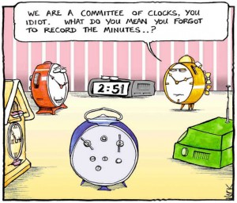
Recording Secretary
The recording secretary records the board of director meeting minutes. The recording secretary also completes the Annual Report to the Membership Form.
Time Commitment: Five hours per month.
Notes:
The recording secretary records the board of director meeting minutes. The recording secretary also completes the Annual Report to the Membership Form.
Time Commitment: Five hours per month.

Slide 20
Resolutions Appointee
The Resolutions and Bylaws Appointee makes recommendations to the Board of Directors regarding Bylaws and Procedure Manual changes as appropriate.
Time Commitment: Approximately five hours per year.
Notes:
The resolutions and bylaws appointee is responsible for maintaining and disseminating current copies of the Bylaws and Procedure Manual to the Board of Directors and makes recommendations to the Board of Directors regarding Bylaws and Procedure Manual changes as appropriate.
Time Commitment: Approximately five hours per year.

Slide 21
Student Liaison Appointee
The Student Liaison Appointee has oversight for the Student Leadership Program.
Time Commitment: One to two hours per month.
Notes:
The Student Liaison Appointee is responsible for updating the Student Leadership Program application in collaboration with the web editors and executive secretary, reviewing completed applications for student eligibility, compiling executive committee rankings and communicating with applicants. The liaison is the primary communicator with all student directors and interns and works with them regarding content and presentation of content for the annual meeting student open forum.
Time Commitment: One to two hours per month.

Slide 22
Survey Appointee
The Survey Appointee updates, administers, and provides the results of the annual membership survey to the Board of Directors.
Time Commitment: Approximately two hours in February and March.
Notes:
The Survey Appointee is responsible for updating, administering, and analyzing the results of the annual membership survey. To do this, the appointees revises the survey with direction from the Board of Directors; updates the survey recipient addresses with direction from the executive secretary; administers the survey to OSRT members; compiles and does a preliminary analysis of the results that are presented to the Board of Directors.
Time Commitment: Approximately two hours in February and March.

Slide 23
Volunteer Responsibilities
Communicate, communicate, communicate
Make sure your completing tasks on time
Ask LOTS of questions, when needed
Have fun!

Slide 24
Tips to Make Volunteers Happy and Productive
Be prepared for them
Make them feel welcomed
Provide good training
Involve them in interesting activities
Communicate time requirements ahead of time
Communicate on a regular basis

Slide 25
Tips to Make Volunteers Happy and Productive
Make them appreciated
Make them know they make a difference
Connect them socially
Teach them new information/skills
http://nonprofit.about.com/od/volunteers/tp/whatvolunteerswant.htm?utm_term=volunteer%20appreciation&utm_content=p1-main-3-title&utm_medium=sem&utm_source=msn&utm_campaign=adid-24f69939-db39-4c50-b764-c6dc5418db10-0-ab_mse_ocode-22848&ad=semD&an=msn_s&am=exact&q=volunteer%20appreciation&dqi=&o=22848&l=sem&qsrc=999&askid=24f69939-db39-4c50-b764-c6dc5418db10-0-ab_mse

Slide 26
Top Ten List for Being a Good Board Member
OSRT Top Ten List for Board Members
Notes:
Finally, lets look at a short video clip that succinctly identifies the top ten characteristics to being a successful board member. Afterwards, think about your personal experiences you have had on a board, or what you anticipate being your strength and areas for improvement and we will talk about them.
What comments or concerns do you have as you move forward, serving either on an OSRT committee or the Board of Directors?
What do you perceive as a strength you bring to the OSRT?
What areas do you need some work to improve upon?

Slide 27
Thank You Volunteers

