Slide 1
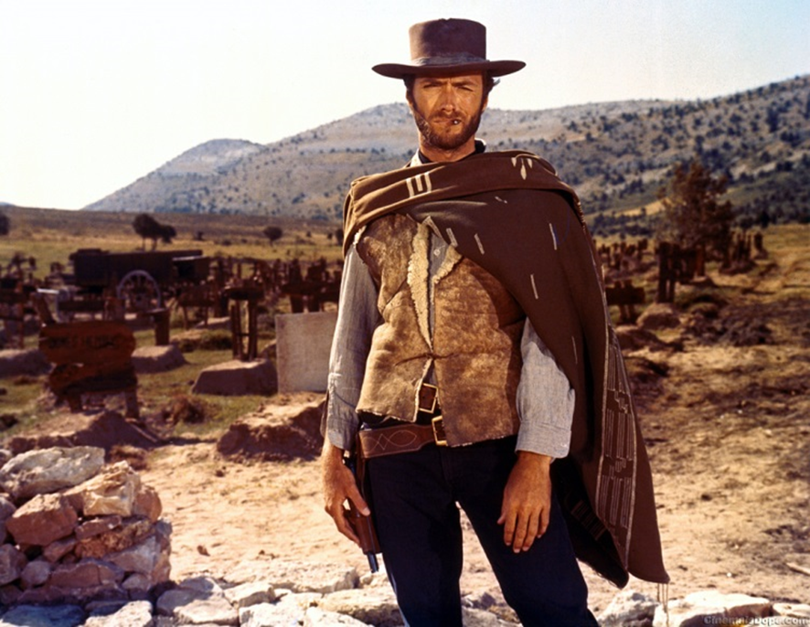
Leadership Styles 101
The Good, the Bad,
and the Ugly

Slide 2
What Traits Make Up a Good Leader?
Self Starter
Passionate about the mission
Accept and motivate others
Servant leader
Deals well with conflict
Strategic thinker
Financial manager
Fund raiser
Good listener
Sound judgement
Persistent
Emotional and physical stamina

Slide 3
Harvard Review Analysis and Discovery
3,000 mid level managers surveyed
The most successful leaders blend leadership styles
They are skilled at several styles and can flex between them as needed

Slide 4
Before We Begin…………..
There are advantages and disadvantages to each style
It is important to know which style best fits you and the situation
No style will work in every situation or for every leadership opportunity
Be open to flexibility
https://www.skillsyouneed.com/quiz/325444

Slide 5
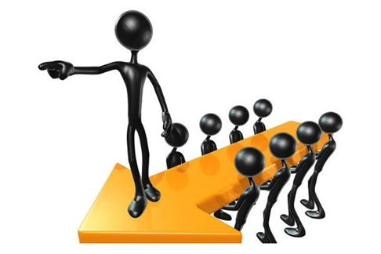
Coercive/Commanding “ Do What I Tell You”
Advantages:
In a crisis, leaders may need this approach to turn things around
It can create immediate results
Disadvantages:
Can make people feel devalued
Can create a negative climate in the environment

Slide 6
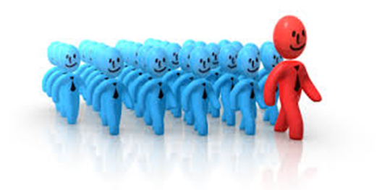
Authoritative/Visionary “ Come With Me”
Advantages:
One of the best styles to guide change within an organization
Enthusiastic and goal orientated approach seen by others
Disadvantages:
The leader must be more knowledgeable than his team
Can appear overbearing and self serving

Slide 7
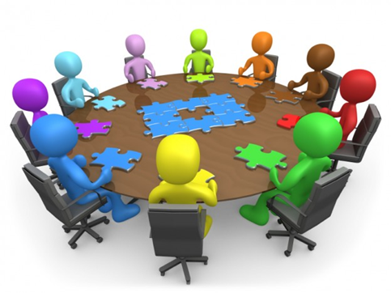
Democratic “What Do You Think?”
Advantages:
Focuses on feedback
Builds trust and respect
Motivational to members
Disadvantages:
Requires competence from members
Requires informed team members to make good decisions
Can be time consuming

Slide 8
Coaching “Try This”
Advantages:
Can maximize effort in some persons
Focuses of strengths and weakness of the person
Encouraging
Disadvantages:
May not be effective if leader is not skilled in the style of leadership
Assumes the person wants to and is willing to learn

Slide 9
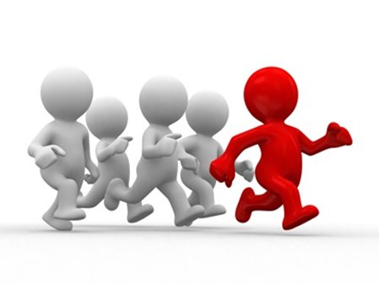
Pacesetting “Do As I Do, Now!”
Advantages:
Motivational to competitive persons
High expectations
Competent persons excel
Disadvantages:
Similar to coercive style
Can undermine morale
Can make people feel devalued

Slide 10
Review of Styles

