Slide 1
Event Planning

Slide 2
Membership Recruitment and Retention
Recruitment – getting new members
Retention – keeping members
Both instrumental for viability of organization

Slide 3
Membership Recruitment and Retention
Why are these important?
Members are the life's blood of the OSRT or any organization
The OSRT depends on not only recruiting new members, but retaining existing members.

Slide 4
Notes:
You may hear exactly this from a member as you ask you ask them to join and it’s a logical question. Many times you need to evaluate what it means to an individual to be a member of an organization. In what ways do they find it beneficial?
Sometimes a retreat can help with this question. When you have several people secluded and focusing on certain ideas, it can develop some new answers. The OSRT did just that as you will see in the next slide!

Slide 5
Membership Retreat
Held August 2015
In 2015, then OSRT President Angie Arnold, organized a Membership retreat to brainstorm ideas to increase membership.
The idea was to attract new members and retain our existing members.

Slide 6
Laying Down the Ground Rules
No discussion - just ideas (in early stages)
No judgments of any idea presented
No expansion or explanation of the idea (initially)
One idea can generate another idea
Notes:
The ground rules help to generate ideas without discarding them quickly. It leads to discussion and possibly revision of the ideas. Ideas can build on one another to grow quickly.

Slide 7
Brainstorming and its Benefits
“Idea generators”
Fosters teamwork and a sense of belonging
Synergistic experience
Everyone participates

Slide 8
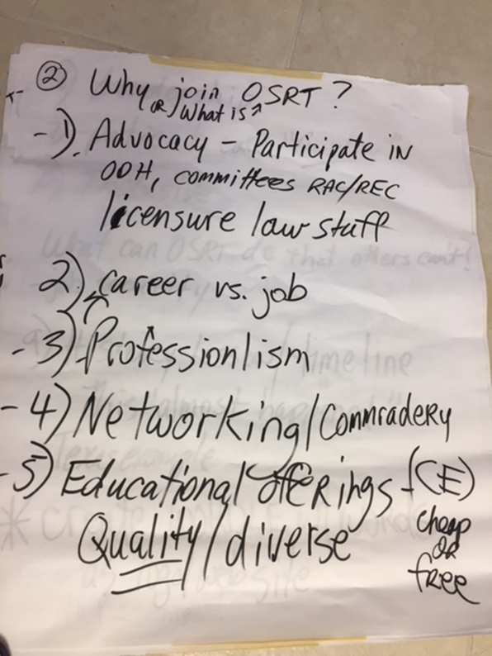
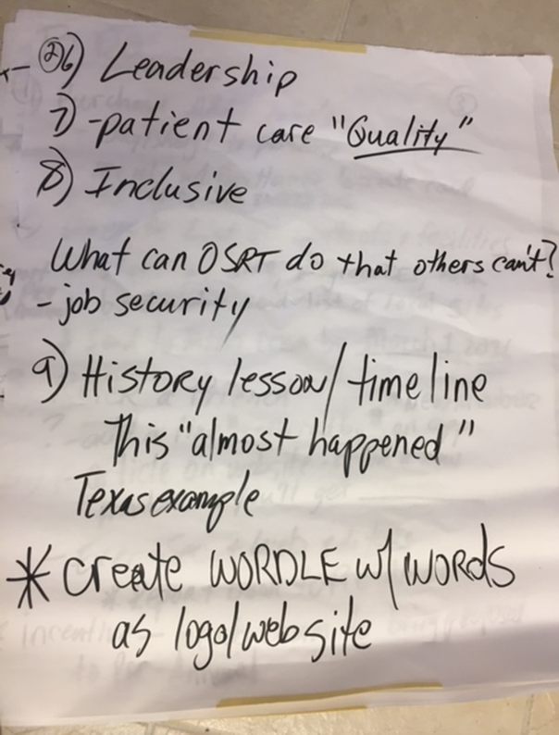
Brainstorming Session
Notes:
These are a few if the ideas that came out of that brainstorming session. As we look at the list its very diverse and we will be brainstorming other ideas later in the academy.

Slide 9
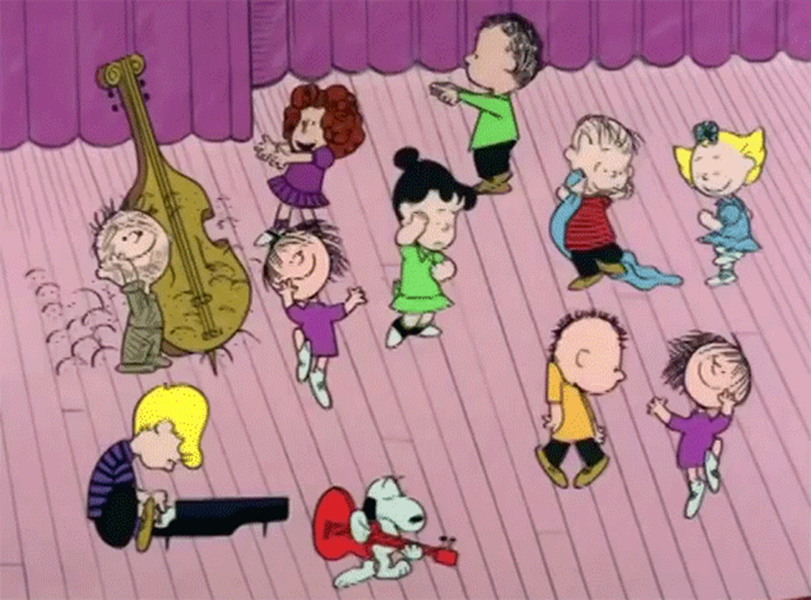
Retreat Outcome
https://www.youtube.com/watch?v=jPgewHpf-q4
Target membership campaign toward educational programs that students are currently not involved in the OSRT.

Slide 10
Ideas from the Brainstorming Session
Spotlight programs on OSRT website.
Reach out to educational programs that currently are not involved.
Visit facilities and talk with technologists.
Produce videos for social media that can act as testimonials for the OSRT.
Hold student days separate from the annual meeting.
Use interns to speak in person to programs using student to student interaction.

Slide 11
Retention Ideas
Publicize /show what OSRT does
Ask the question, “ What would make you stay a member?”
Use personal communication rather than electronic communication
Phone calls are an opportunity to ask questions
Leadership opportunities

Slide 12
Next Steps
The next step is to take all the ideas and organize them
Place them in separate columns on a wall board or white board
You may find two ideas that are similar
You can try and combine ideas, but respect the two persons by asking them first before you try it
Separate by new membership vs. retention ideas

Slide 13
Next Steps
Discard ideas that are not feasible or practical
Focus on a few good ideas by group vote
Determine if the ideas actually answer the question
If not, plan another session for another day
If so, plan another session to refine the ideas and create a plan to act on them

Slide 14
Event Planning

Slide 15
OSRT Annual Meeting
Notes:
The Annual Meeting is the largest event presented by the OSRT, generally held each April.
It is an avenue for the OSRT to get the word out about membership benefits.
It is a way for the membership to interact directly with the board members in the business session.
It is also the largest revenue generator for the OSRT.

Slide 16
Planning
The Annual Meeting planning begins well over a year before it is presented.
Several persons and committees assist in this process.

Slide 17
Connections
Committees share information frequently to assure the strategic plan is followed.
For example, the Education committee shares speaker ideas with the meeting AM co-chairs.
Marketing and Sales Committee helps to secure vendors to present at the meeting.
The financial manager is integral in securing contracts with the hotel and vendors and budget concerns with AM chairpersons assistance.

Slide 18
Connections
OSRT Executive Secretary gives frequent updates on member attendance numbers at the meeting well before the event.
Once you are assigned to the AM as a chairperson or committee member, you will see the scope and magnitude of the man-hours needed for a successful meeting.

Slide 19
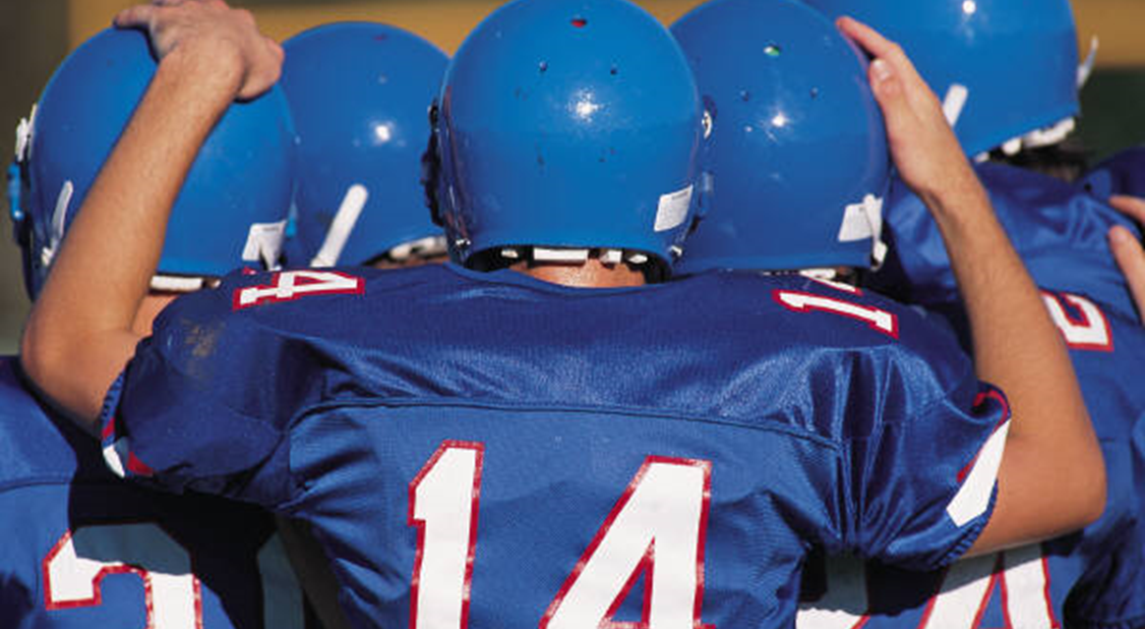
Game Time!

Slide 20
Responsibilities of the AM Committee
AM committee recruits volunteers to assist while at the meeting.
Examples of responsibilities can be:
Room moderators
Set up persons between sessions
Audio visual persons
Registration assistance
All people have to work together as a well oiled machine to ensure a successful meeting!

Slide 21
Success!!!!!

Slide 22
Post-Annual Meeting Review and Evaluation
Ask the difficult questions such as:
What worked well during the meeting?
What areas need improvement?
What did attendees have to say about the meeting?
What was the quality of the speakers used in the meeting?
The list above is just a few questions that need answered to improve the meeting for next year.

Slide 23
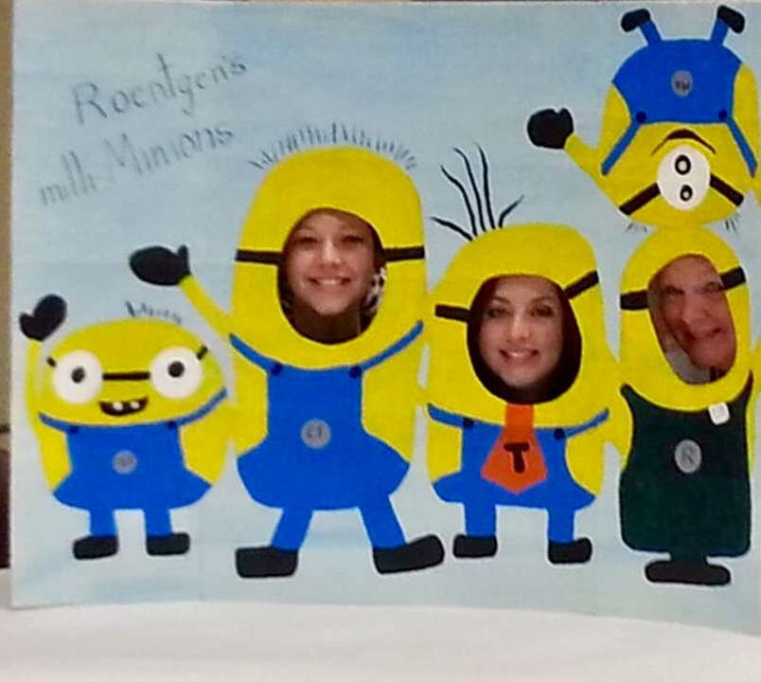
Annual Meeting Experiences

Slide 24
Questions????

