Slide 1
CT of the Head, Spine, and Cerebral Vessels

Slide 2
Objectives
Determine specific imaging plane used to acquire or reformat CT scan, i.e. sagittal, coronal, transverse, and off-axis or oblique.
Assess and evaluate CT scans for use of contrast media.
Differentiate between normal anatomy and pathological processes.
Critique CT scan for proper positioning, acquisition methods, parameter selections, and any protocol modifications.
Investigate methods to reduce radiation during CT procedures.

Slide 3
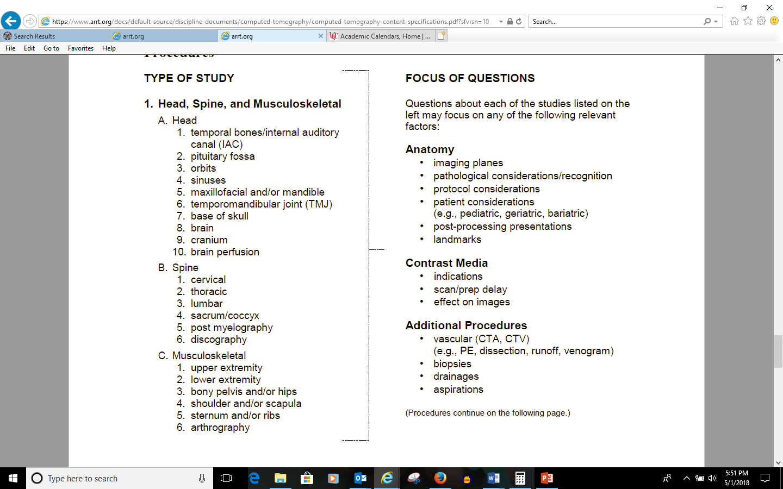

Slide 4
Patient Preparation
Metallic objects
Fasting
Empty bladder
Patient anxiety
Contrast injection
Medications
Comfort
Eyes (laser positioning light)
Notes:
Metallic objects- free of all jewelry, hairpins, metal gown snaps, wires, attached to patient
Fasting-not required for non contrast, however when you using IV contrast eating for about 4 hours prior to the scan, if possible. In a stroke situation it might not be and then contrast could cause vomiting.
Empty bladder- important depending on how long the patient will be on the table, especially if the a biopsy is going to be performed. Helps with patient comfort and the patient’s ability to hold still.
Anxiety- can be eased by the calm demeanor of the technologists and giving short patient friendly explanations about the procedures, describing all sensations the patient might experience during the scan is very important.
Contrast injection- review of drug or medication allergies and renal function. Choosing the appropriate IV size and location is important, at least a 20 gauge above the wrist, preferably the anticubital vein
Medications-might be given for cardiac, which might be relevant for CTA.
Comfort-extremely important for the patient to hold still, help to lessen motion, might use restraints for patients that are unresponsive or incoherent.
Eyes- protect the eyes from the laser light have patient close their eyes.

Slide 5
Challenging Patients
Combative or uncooperative patients
Body fluid protection
Notes:
Combative or uncooperative patients- could be caused by dementia, head injuries, or intoxication. Use of restraints
Body fluid protection-always be observed and use of gloves, when appropriate might need to wear gloves or masks.

Slide 6
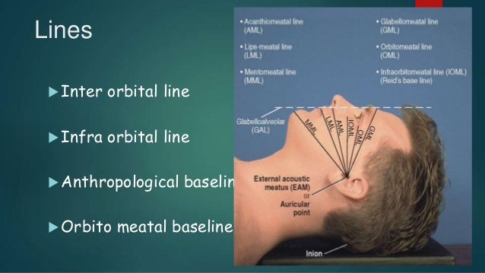
Scanning Protocols - Head
OM line
Transverse plane
  Reformats - thin slices
Direct coronals
  Sinuses (air-fluid levels)
  Temporal petrous bones/IACs/Sella turcica
Algorithm (kernel)
Contrast enhancement
http://www.slideshare.net/sajithroy/positioning-of-skull
Notes:
CT scanners preset protocols/techniques and a variety of slice thicknesses and all depend on the make and model of manufacture. Usually the applications specialist will work with the radiologist and lead tech/super user to input while they are there. It will be important to pay attention some times they will say things like, do not change this, and give reasons.
Orbitomeatal line (OML) used for positioning which is the imaginary line that starts at the outer canthus of the eye (corner of the eye) to EAM or external auditory meatus at the ear. Your book talks about the OML being referred to as Reids baseline, but that is incorrect. The infraorbital meatal line is also referred as the Reid’s baseline. CM line or canthomeatal line can be used. Outer cantus of the eye to the center of the external auditory canal. The diffenence in these lines are 10 degrees. IOML and OML difference is 7-8
Transverse most common acquisition plane, avoid scanning eyes more than once.
Some centers direct coronal for sinsuses or other roof of orbitals, structures that are parallel to the transverse plane, patient either prone or supine with head hyperextended.
Acquire with thin images and reformat them.
Coronal images are useful when the structures run parallel to the transverse plane and are being assessed-i.e. orbits, sella, and sinuses (air fluid levels), along with skull base and vertex.
Direct coronals are obtained for structures such as temporal/petrous bones, IAC, and sella at .6-1.25 mm, because there is better resolution and orbits are avoided. During sinus exams air-fluid levels pool away form the path of drainage.
Bone algorithm, some structures maybe obtained using a low mA, but other structures (petrous portion) need higher mA. Algorithm chosen affect the resolution of the images, depending on the pathology low mA could be used. There are a lot of very dense bony structures, that sometimes make this impossible
Contrast-not visible on bone, can be used for soft tissue and are required to see vessels and tumors and chronic sinus infections.

Slide 7
Indications
Head and face
Cerebral blood vessels
Spine and neck
Notes:
CT valuable for assessing intracranial pathological conditions in the acute stage.
Which line must be parallel to the axial scan plane for CT examinations? OML
Acute neurological function that presents in paralysis (stroke) or TIA. These could be caused by a blockage in a blood vessel. A spontaneous brain hemorrhage caused by hypertension or an underlying blood vessel abnormality-aneurysm, infection, or tumor. Do your homework. Contrast vs. non contrast. Also make sure that you have a complete history and if you are doing contrast if you need a non contrast first.

Slide 8
Head Positioning
Center the patients head in the gantry
Identify patients
Select protocol
Scout
Scan range: Base of skull/C1-vertex
Notes:
Center of the gantry is referred to as…isocenter. Table height positioned to the EAM and zeroed to the patients mental point (caudocranial scout)
How many identifiers…2

Slide 9
Head Scan
Axial vs. helical
SFOV: 25 cm, 50cm (sometimes)
120 kVp
200-600 mAs
Slice thickness: 5mm
Notes:
Axial acquisition-greater detail with less noise can demonstrate delicate anatomy
Helical-vascular for post processing
Important to know scanning protocol and parameters
Foramen magnum through the vertex and angled parallel to the OML

Slide 10
Head Scan
Pitch single: 1-1.7
Pitch multidetector: .7-1.0
WW: 80-100
WL 20-40
Notes:
Standard algorithm
Visualization of sharp or bony detail. WW 2000-2500; WL 200-300

Slide 11
Head Scan
Annotate
Infused with power injector
Contrast: 100 mL
Delay
Notes:
Pre vs. post
Slower flow rates-ask about institutional protocols
Institutional protocol.

Slide 12
Head and Face
CT is valuable for assessing intracranial pathological conditions, especially in the acute stage
  Cerebral infarction
  Hemorrhage
  Aneurysm
  Hematoma
  Trauma
  Infection
  Tumors
  Congenital defects
Notes:
Cerebral infarction-loss of adequate blood supply to a portion of the brain. May be difficult to see in early of the infarcted tissue. As the infarct matures, it becomes more obvious and better defined. B/c of the increased water content of the infarcted tissue the density is decreased.
Hemorrhage-brain substance can occur spontaneously either because of an underlying vascular anomaly, tumor or AVM, or because the patient’s hypertension has weakened the walls of the capillary vessels. Can occur in the subarachnoid space resulting in bloody CSF or between the brain and its meninges. Acutely extravasated blood is of increased density and is white. The degree of mass effect caused by the hematoma is reflected in the amount of brainstem compression from the shift of the midline structures. The effects of the patient’s level of consciousness is measured by the glascow coma scale. Delay in scanning should be avoided, patients LOC can change within 5 mins.
Hematomas evolve in density over time becoming less and less dense and finally approach CSF in density.
Trauma-If a trauma is suspected, CT provides rapid information about contusions (brain bruise) and hematomas (blood clot) in the brain and in the spaces between skull and brain. Facial fractures are easily seen. Measure depth of depressed bone fragments can be measured. Also, results of corrective surgery and the location of metallic hardware in face, as well as the degree of healing callus, good for follow up examinations.
Aneurysm-Bulging or pouch like abnormality of a blood vessel
Infection- meningitis or encephalitis, useful to analyze the CSF for the presence or cells and various compounds, such as gluclose, protiens, antibodies, and bacterial and viruses. Brain atrophy can result in large ventricles and must be distinguished from hydrocephalus. LP can only be preformed if the possibility of an intracranial mass is ruled out.
Tumors-most common form of tumor is a metastasis. They are most often multiple. Common primary brain tumors are meningioma and glioblastoma multifrome (GMB). Their location and pattern of enhancement is used to predict their pattern of enhancement and to predict if they can be surgically removed. Stereotaxic procedures by various methods are commonplace in neurosurgery. They are used to accurately localize the lesion before the biopsy. Preoperative studies can be obtained with fidual markers applied to the scalp or with the head in a stereotaxic frame. Different attachments are available on older systems. Newer systems are frameless, using combination of computer programs to superimpose the images and correlate them to the patient’s anatomy.
Congenital brain abnormalities- diagnosed in childhood, seizure disorders (localized arrested brain development). Some abnormalities remain asymptomatic, found by accident

Slide 13
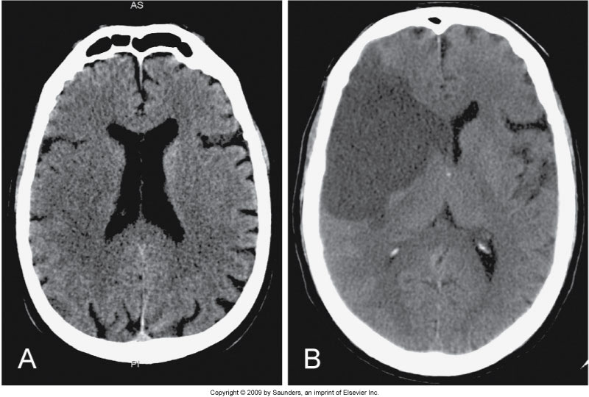
Infarction
Figure 17-1 A, Early subtle infarction. B, Late well-defined cerebral infarction. Subtle loss of the distinction between the gray and the white matter is present on the early CT, in the right middle cerebral artery territory, with good delineation of the affected area on the later CT.

Slide 14
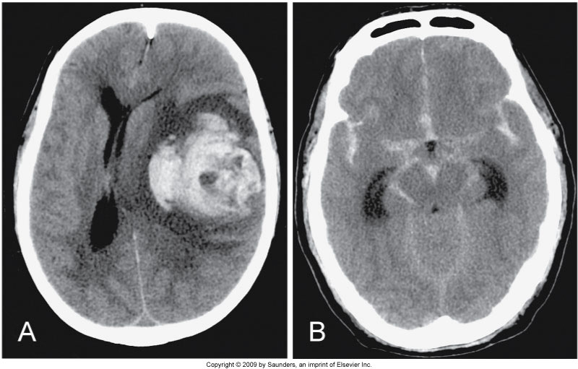
Hematoma
Figure 17-2 A, Large left parenchymal hematoma causing a marked midline shift to the right. B, Severe subarachnoid hemorrhage outlining all the cisterns of the skull base.

Slide 15
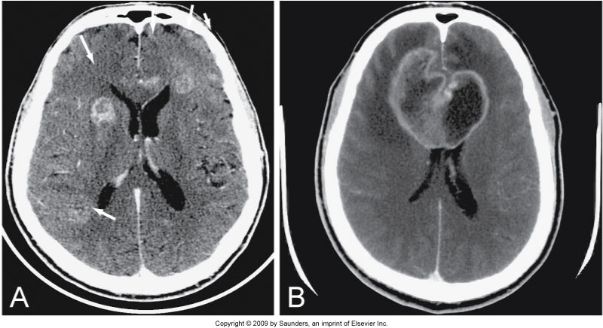
Metastasis
Figure 17-4 A, Multiple ring enhancing metastases in both frontal lobes. B, Enhancing bifrontal (butterfly) GBM; it is surrounded by edema, causing mass effect on the frontal horns.

Slide 16
Other Conditions in the Head and Face
Sinus disease
Mandible
Orbits
Trauma
Pituitary
IACs
Notes:
Sinus or sinusitis- sinus anatomy shows many variations important to the ear, nose, and throat surgeon. Complications such as entering the brain or orbit inadvertently, sinus surgery is often performed with direct correlation with CT images, a procedure known as functional endoscopic sinus surgery, FESS.
Mandible-curved bone is hard to assess with conventional x-ray, but can be easily evaluated with CT and then reformatted with 3-D
Orbits- CT scans in 2 planes (axial and coronal) because of the pyramidal shape of the bony orbit. Intra orbital fat delineates the optic nerve, extaocular muscles, and superior ophthalmic veins. CT can accurately localize foreign bodies, orbital mass lesions, and identify the cause of displacement of the globe. While metal is radiopaque it can be seen very easily, however wood is not radiopaque foreign body and sometimes mimics air, reformatting in a bone window will be very important. Very good at visualizing orbital mass lesions and can help to identify the cause of proptosis-displacement of the globe.
2D and 3D reconstructions and reformats can help to identify fractures that may be missed on conventional x-ray and help surgeons to reconstruct facial structures.
Pituitary and IAC’s-microadenoma which can cause endocrine problems and masses in the inner ear which can cause hearing loss.

Slide 17
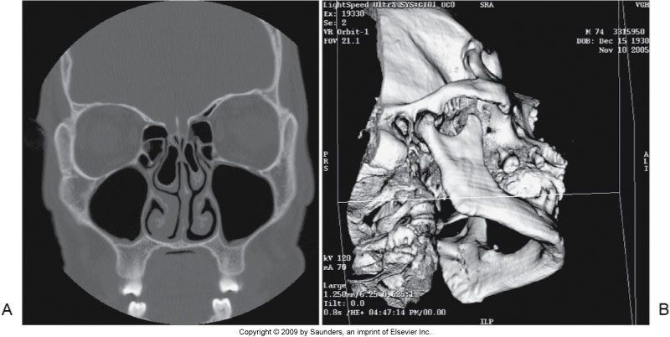
Sinuses
Figure 17-6 A, Paranasal sinuses obtained prone to better see the drainage pathways of the maxillary sinuses (known as the ostia). B, Reformatted three-dimensional image of the mandible. The image can be rotated on the computer to evaluate all the margins of this curved bone.

Slide 18
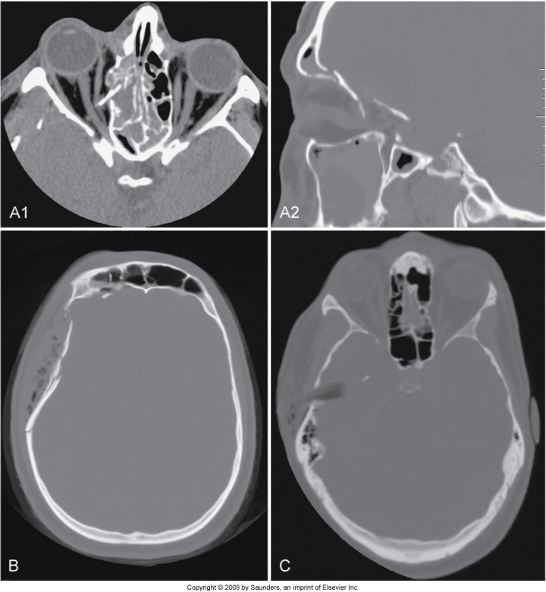
Trauma
Figure 17-3 A, Orbital roof fractures; the transverse image on orbit settings shows the bone fragment spearing the right medial rectus muscle and the sagittal image on bone windows shows the rotation of this fragment. B, Comminuted depressed skull fracture with subcutaneous emphysema and fluid in the right frontal sinus. C, Wooden stick piercing the right temporal bone and lobe, displacing a fragment of bone into the brain, better appreciated on wide windows (it mimics air on routine brain windows, not shown).

Slide 19
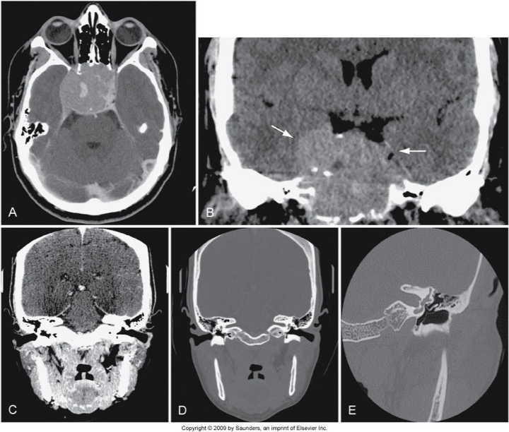
Pituitary and IACs
Figure 17-7 A and B, Very large pituitary adenoma, filling the sphenoid sinus but not abutting on the optic chiasm, imaged in transverse plane and reformatted in coronal plane. C and D, Direct (i.e., with neck extension) coronal images of the internal auditory canals (IAC), on soft tissue (C) and bone (D) algorithms. E, Left petrous bone, acquired in direct coronal plane, showing the ossicles in the middle ear, surrounded by air.

Slide 20
Spine
Trauma
Masses/tumors
Infections
Arthritis
Scoliosis
Notes:
CT has replaced conventional films for trauma due to the sensitivity of identifying fractures that might be obscured on conventional radiography. It is also easier and quicker for the patient. Contrast can also be given to the patient to identify injuries to the carotid and vertebral arteries that may result in dissection. Can also show some herniation or spinal compression. Overlap of structures with in the cervical region because of conditions affecting the vessels, the bones, and the soft tissues are often found when one type of cervical exam is preformed, most evident study is a CTA covering the neck. In addition to bone and vessels, abnormalities of the thyroid gland, the salivary glands, lymph nodes, and neck muscles.
Trauma- carotid and vertebral artery dissection or occlusion during violent neck motion that caused a spinal fracture or dislocation.
Usually older patients with carotid stenosis caused by arteriosclerosis.
Incidental findings
Masses-can occur along chains of lymph nodes (hodgkins lymphoma), tumors can arise from the salivary glands, nasopharynx, tongue, and floor of mouth or metastases to the neck nodes. Other tumors that can be can be would be a goiter or enlargement of the thyroid gland.
Infections such as diskitis or osteomyelitis at any level of the spine. They can also spread to the epidural space that can result in spinal compression and paralysis.
Tumors affecting the spine or spinal cord can originate as primary tumors or metastasize from other sites to bone or soft tissue, affecting the vertebral bodies, pedicles, laminae, and facet joints. Treatment-bone removal which can result in instability. Hardware is sometimes surgically inserted, but can fail leading to these individuals have frequent followups.
Instrumentation can also be used to treat atlantoaxial instability caused by arthritis and treating scolosis, spine fractures, spinal stenosis, spondylolisthesis-which requires accurate placement of pedicle screws, hooks, wires, and plates. Accurately depicits the placement of the hardware. The screws can sometimes impinge on a nerve root or verterbral artery and cause neurological deficits or pain.
Vertebroplasty. Radiopaque cement can be injected under fluoroscopic control into the spinal compression fractures to reduce pain and in some cases to decrease the kyphosis.
Other chronic conditions that can be evaluated in the spine would be arthritis and scoliosis.

Slide 21
Cervical Spine
Scan mode: spiral
SFOV: 50 cm
DFOV: 12 cm
No gantry angle
Scanning range: base of skull to T2 inferiorly
Ensure the patient is centered
Notes:
C spines usually involve 2 scouts AP and Lateral

Slide 22
Cerebral Blood Vessels
CT Angiography
  Stenosis
  Thrombosis
  Cerebral infarction
    CT perfusion
Notes:
Using contrast injections CT can extend the length of the vascular tree that can be imaged with one contrast injection. Speed of image acquisition, an injector is used to inject the contrast, greater scan lengths are possible with a greater number of simultaneous slices. Artifacts caused over the carotid arteries by metal in the mouth, i.e. dental fillings, caps, and braces cannot be completely eliminated.
CTA can outline the cerebral blood vessels from their origin on the aortic arch to their various intracranial branches. The number of patients being investigated for vascular conditions has multiplied.
Vessels that supply the brain originate from the aortic arch- brachiocephalic trunk, left common carotid (site for stenosis), left subclavian. The subclavian and the vertebral arteries and the common carotid artery bifurcation (site of most stenosis). The internal carotid arteries , the intracranial arteries (anterior, middle, posterior cerebral, basilar and cerebellar, which are aneurysm sites, very visible. as well as the vertebral arteries and the vessels that make up the circle of willis (anterior, middle, and posterior cerebral, basilar, and cerebellar) cow for short
There should be a few seconds delay @12-14 on most people between contrast injection and image acquisition of the entire brain. You will also be able to visualize the veins such as juglar, dural sinsuses which can be sites for thrombosis.
CTA is important in the diagnosis of cerebral infarction, because it is fast and leads to rapid intervention that can result in less brain damage.
A non contrast CT should be performed to rule out hemorrhage, CT perfusion and CTA for the suspected infarct, then if and when identified then TPA can be administered.
Perfusion is the physiology part that helps to show which area of the brain the infarction has affected. Also can show the physicians how much brain might be at risk for permanent damage.
Patients with a hemorrhage caused by a suspected aneurysm or an AVM can undergo a CTA to confirm the diagnosis before being transferred to a more specific or specialized treatment center.

Slide 23
Cervical Spine
Compliment to radiographs
Reformats excellent view of alignment and vertebrae
Trauma vs. routine
Arms extended down
Remove metal
Hold still, no swallowing or breathing.

Slide 24
Cervical Spine
Place patient in the center of table
EAM through T1
Lateral laser light mid coronal plane of spine
Contrast vs non contrast

Slide 25
Cervical spine
kVp 120-140
mAs 250-350
Slice thickness: 2 mm
Slice interval: 2 mm
Pitch: .75-1.25
Notes:
Utilization of auto mA dose modulation
Collimation differ due to departmental protocol.

Slide 26
Cervical spine
Slice thickness: 2 mm
Slice interval: 2 mm
Pitch: .75-1.25
Notes:
Trauma reconstructions done at 1mm

Slide 27
Cervical spine
Matrix 512 x 512
Standard algorithm:
  WW 300-500
  WL 40-50
Bone algorithm
  WW 2000
  WL 200
Notes:
Trauma reconstructions done at 1mm

Slide 28
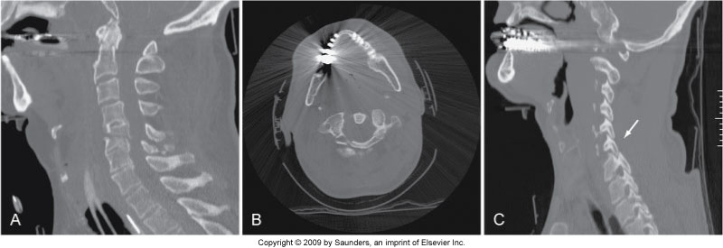
Fractures
Figure 17-10 A, Reformatted image of the cervical spine showing fractures of C2 and C5. Multiple spinal fractures are not uncommon. B, Metal causes streak artifacts but still demonstrates the C1 fracture. C, Alignment is a critical component of spinal assessment. A facet lock is present.

Slide 29
Thoracic

Slide 30
Lumbar

Slide 31
Sacrum/Coccyx

Slide 32
Post Myelogram

Slide 33
Discography

Slide 34
CT Angiography (CTA)
Technical requirements
  Patient preparation
  Acquisition parameters
  Contrast medium administration
  Image postprocessing techniques
    Mulitplanar reconstruction
    Maximum intensity projection
    Volume rendering
    Interactive cine
Notes:
Patient prep: tech and rad work in conjunction to obtain appropriate and correct information from the patient and ensure that the patient understands the procedure, particularly breath-holding techniques.
Acquisition parameters: CT exam proceeds the CTA part of the exam, parameters include scan time (s), slice thickness (mm), pitch or speed of the patient through the gantry (mm/s). Careful selection of kV and mA which will be determined by the size of the patient and level of noise in the images. Isotropic imaging (voxels are perfect cubes). Reconstruction interval play an important role in the quality of the image. Overlapping reconstructions improve the 3D image quality. Spatial resolution is also influenced by the reconstruction algorithm. Ideal kernel would combine low image noise and sharp edge definition, maintaining good low-contrast resolution.
Contrast administrated: contrast administration is critical for a good CTA image. Volume and timing of the contrast bolus are 2 important considerations. Measuring contrast circulation times for different patients is important to ensure images are recorded when flow-in of contrast is optimum in the vessels. There are now automated systems per manufacturer like CARE bolus (Siemens), SmartPrep (GE), SureStart (Toshiba) the products optimize the contrast monitoring in CTA. The scan is triggered to start when the the CT number being measured by the region of interest (ROI) changes reaches a predetermined enhancement. There is real time monitoring of the contrast, this allows the technologist to manually start the scan if it doesn’t trigger at the set CT number. Other important consideration is the catheter size and the vein used for the injection. An 18 or 20 gauge needle placed in a large vein, such as the antecubital vein.
Image postprocessing:
MPR-simple and fast to reconstruct, less useful in complicated vessels-Circle of willis, intracranial AVM-excellent spatial resolution due to perfect voxel cubes
MIP-most frequently used editing to remove unwanted structures (bone and calcified plaques) successful in separating out the vascular calcifications, lumen, thrombus, and intravascular thrombus.
Volume rendering-3D used in VR, uses all information in the axial set to display the information in the axial data set to display internal structures, and provided accurate vessel diameters and 3D vascular relationships.
Interactive cine: viewing and evaluation of the images in the axial data set by panning through the set of axial images, helps to demonstrate anatomical relationships

Slide 35
Radiographic Technique
mA, kV, helical pitch, rotation time
Slice thickness
Matrix size
Reconstruction algorithms
Notes:
Even though there are preset protocols there are several exposure factors you need to be able to change including mA, kV, pitch, scan time, slice thickness
Increasing mA and kVp will improve signal to noise ratio. Sufficiently high technique is necessary for contrast resolution of soft tissue in the brain gray-white matter differentiation. Spine imaging can also be improved by increasing technique. Increase patient dose
Increasing scan rotation time will result in better resolution because each image is generated more projections. Increasing pitch results in shorter scan time but reduces the overall image quality because of more interpolation in the scan data. Longer scan times can result in longer tube cooling and patient motion.
Slice thickness (@ 1-5 mm) area of interest, usually helically, but brain can be done sequentially for better resolution. Spatial resolution is better with thinner slices, but decreased signal to noise ration and an increase the radiation dose. Average slice thickness has decreased over the years from 10mm to 5-2,5mm for the head. Orbits are 1-2mm, temporal bone .6-1mm with 10 cm FOV, CTA images 1 mm helical; however CTP 5-10mm, cervical is imaged with helical 1-2mm slice every 1-2 mm. Cervical spine deal with shoulders. Lumbar 3-5 mm every 3-4mm. Sometimes overlap slices are used to improve visualization of herniated lumbar disks. Scatter radiation can be increased with larger gerth.
Matrix- predetermined 512x512 some systems have 1024x1024. many reconstruction algorithms are available. The 2 basics algorithms are available standard, bone, and detail. Standard-soft tissue imaging, intervertebral imaging; detail-soft tissues of the neck, increasing of edge definition, and bone to increase the sharpness of bone and optimize spatial resolution
Standard-chosen for most soft tissue imaging-good contrast resolution. Important to distinguish gray from white matter when looking for acute cerebral infraction.
Detail-studying the soft tissues of the neck. Increases edge definition, good definition of lymph nodes and fat planes.
This algorithm optimizes spatial resolution, but contrast resolution is poor, not used inconjunction with IV contrast, however when visualizing subarachnoid intrathecal contrast it is preferred.

Slide 36
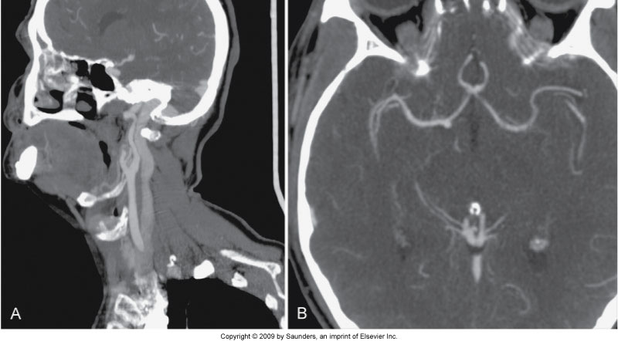
CTA of Carotid Bifurcation
Figure 17-8 A, Normal CTA of the common carotid bifurcation, showing the Y-shaped arteries and the large jugular vein posterior to it. B, Normal CTA of the circle of Willis, showing the anterior communicating artery and both middle cerebral arteries.

Slide 37
Angiography
Replacing conventional angiography
Reconstruction in multiplanar sections
Imaging of hepatic, renal, messentric, iliac, and femoral arties
Contrast and timing
Positioning
Notes:
Bolus tracking, cardiac output, localization of IV and size (18 gauage antecubital vein)
Full peak enhancement

Slide 38
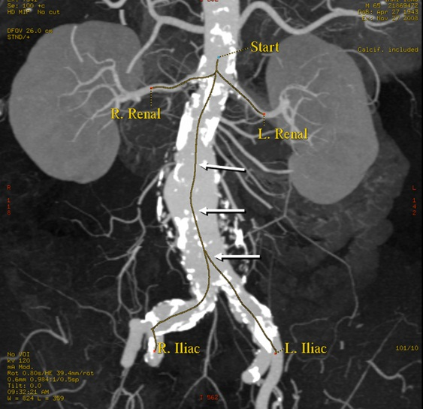
Angiography
Mid chest through symphysis
Spiral
SFOV
DFOV
Scan range
Parameters
WW 550-700
WL 40-70Matrix 512 x 512
https://www.intechopen.com/books/aneurysm/abdominal-aortic-aneurysm-in-different-races-epidemiologic-features-and-morphologic-clinical-implica
Notes:
Scan fov-50 cm
DFOV-smallest
Scan range above dome of the liver to the iliac crest entire aorta needed
Parameters-no anglulation of gantry, 225-275 mA-dose modulation again, kVp 120, slice thickness 2mm, slice interval 1 mm, pitch .75-1.35 less or near 1 (reformats)
Post processing-2nd half, department protocols 2-5 mm slice n

Slide 39
Angiography
Post processing
Reformations
Notes:
Post processing-2nd half, department protocols 2-5 mm slice
Oblique, sagittal, coronal, 3 D volume rendering
Thin overlapping slices
https://www.intechopen.com/books/aneurysm/abdominal-aortic-aneurysm-in-different-races-epidemiologic-features-and-morphologic-clinical-implica

Slide 40
Angiography
CTA timing
Trigger: 125-150 HU
Injection rate 4 mL/second
Amount: 100-125 mL
Notes:
Bolus tracking software
High speed
https://www.intechopen.com/books/aneurysm/abdominal-aortic-aneurysm-in-different-races-epidemiologic-features-and-morphologic-clinical-implica

Slide 41
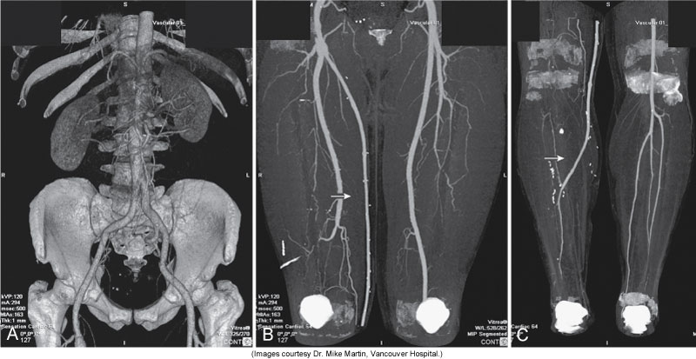
CT Runoff Angiogram
Figure 18-23 CT runoff angiogram demonstrating the entire vascular tree from the aorta to the lower calves. 3D reconstruction of the aorta and iliac arteries (A). Maximum intensity projection image of the thighs (B) demonstrating a femoral graft on the right (arrow) replacing the occluded superficial femoral artery. Maximum intensity projection image of the calves (C) demonstrating that the graft (arrow) has been anastomosed to one of the runoff branches. Most of the bony structures have been segmented and removed. (Images courtesy Dr. Mike Martin, Vancouver Hospital.)

Slide 42
Musculoskeletal System
Protocols tailored to each of the different anatomical regions of the musculoskeletal system
Tailor to the problem
CT used to visualize bony abnormalities in correlation with plain radiographs
Precise positioning is important
When possible both unaffected and affected sides structures assessed for comparison
Indications: masses/tumors, trauma, osteomyelitis
Notes:
Masses and tumors -2.5-5mm (small lesions 1-3mm) smaller anatomical regions-ankles/wrists-.5mm-1mm slices
Displayed and viewed in 2 windows-bone and soft tissue
Sometimes, images with higher resolution may be necessary to improve bony detail. MPR and 3D reconstructions can be helpful with complicated anatomy or evalusaton of fractures.
When assessing tumors, infection, or relationship to neurovascular structures are assessed, bolus injection of IV is required, also helpful in examining joints spaces

Slide 43
Musculoskeletal System
Supine/prone/oblique
Feet or head first
Extremity centered

Slide 44
Examination Preparation
Spiral
SFOV 25 cm
DFOV 12 cm or smaller
Departmental protocols

Slide 45
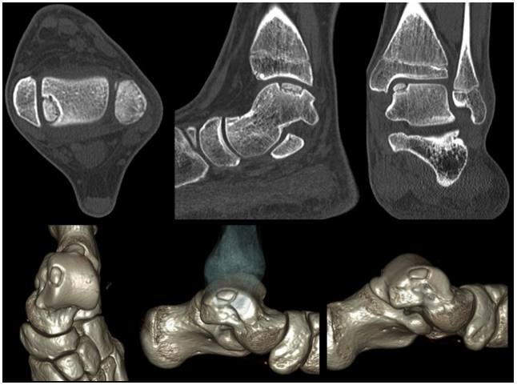
Examination
Matrix 512 x 512
kVp 120-140
mAs 180-220
Slice thickness
Reconstruction 1.25 mm and interval of 0.6
Departmental protocols
http://www.scielo.br/scielo.php?script=sci_arttext&pid=S0102-36162016000500489&lng=es&tlng=en
Notes:
Thin slices with overlap at least 50% greatest detail smooth

Slide 46
Examination
Pitch .5-1.0
Bone algorithm
Soft Tissue
Reconstruction
http://www.scielo.br/scielo.php?script=sci_arttext&pid=S0102-36162016000500489&lng=es&tlng=en
Notes:
Thin slices with overlap at least 50% greatest detail smooth
WW 2000
WL 200
Soft tissue WW 400 WL 40

Slide 47
Test your knowledge??
Indications for CT imaging of the head are:
  Stroke and cerebral infarction
  Hemorrhage in the brain substance
  Chronic subdural hematoma
  Primary brain tumors are meningioma and glioblastoma
  1 and 2
  2 and 3
  3 and 4
  1,2,3, and 4
Notes:
D

Slide 48
Test your knowledge??
Which of the following conditions relates to a loss of adequate blood supply to a portion of the brain?
  Tumor in the brainstem
  Hemorrhage in the brain substance
  Cerebral infarction
  meningioma
Notes:
C

Slide 49
Test your knowledge??
CT of the neck would not be performed if the indication written on the request is:
Polyps
Mass
Stenosis of the carotid artery
Goiter
Notes:
A

Slide 50
Test your knowledge??
The following are indications for CT of the spine except:
Herniation of the vertebral disk
Stroke
Osteomyelitis
Spondylolisthesis
Notes:
B

Slide 51
Test your knowledge??
When preforming a CT examination of the head, images are principally obtained in the following plane:
Sagittal
Oblique
Coronal
transverse
Notes:
D

Slide 52
Test your knowledge??
When positioning a patient for a skull CT examination, the image plane that still remains the most popular is the:
Sagittal
Oblique
Coronal
Transverse
Notes:
D

Slide 53
Test your knowledge??
When preforming CT of the head, neck, and spine, the technologists uses all of the following algorithms except:
Bone
Lung
Standard
Detail
Notes:
B

Slide 54
Test your knowledge??
The slices that provide optimum generation of reformatted CT images are:
Thick slices
Thin slices
Good quality reformatted are absolutely dependent on the technologist
15mm slice thickness
Notes:
B

Slide 55
Test your knowledge??
Which of the following pitches will result in the greatest dose to the patient having a CT of the head:
1
1.5
2
3
Notes:
A

Slide 56
Test your knowledge??
Which of the following pitches will result in the poorest image quality?
1
1.5
2.5
3.5
Notes:
D

