Slide 1

1

Slide 2
CT Registry Review
February 23 and 24, 2019

Slide 3
CT Image Production
(Physics)

Slide 4

Computed Tomography
Content Specifications:
Patient Care
• 22
Safety
• 20
Image Production
• 55
Procedures
• 68
Image Formation – 30
Image Evaluation and Archiving ‐ 25
TOTAL
  165 questions
© 2018 OSRT_Gialousis
4

Slide 5
Objectives
Identify the basic components, as well as their functions, of a CT scanner.
Define CT Scanner geometry as it relates to detector configuration.
Explain the CT imaging parameters and their relationship to the physical principles of radiation interaction.
Discuss the different methods of image acquisition and reconstruction.
Explain the principles of image quality and how image display effects these principles.
Discuss artifacts; their causes and how to resolve them.
Define and explain the post‐processing techniques used in CT.
Discuss the archiving, networking and security of CT images.
© 2018 OSRT_Gialousis
5

Slide 6
Image Formation
CT System Principles, Operation, and Components
Imaging Parameters and Data Acquisition
Imaging Processing
© 2018 OSRT_Gialousis
6

Slide 7
Image Formation
CT System Principles, Operation, and Components
  1. Tube
    X‐ray production
    Warm‐up procedures
  2. Collimation/beam width
  3. Generator
  4. Detectors
    Detector configuration
    Detector collimation
  5. Data Acquisition
  6. Computer and Array Processor
Imaging Parameters and Data Acquisition
Imaging Processing
© 2018 OSRT_Gialousis
7

Slide 8
Image Formation:
CT System Principles, Operation, and Components
The CT Scanner System
  The CT x‐ray tube generator
  The CT x‐ray tube
  The CT beam filter
  The CT collimators
  The CT detectors and the DAS
  The computer
© 2018 OSRT_Gialousis
8

Slide 9
Image Formation:
CT System Principles, Operation, and Components
Generator
  CT scanners use three‐phase power
  High frequency generators
    Located within the CT gantry
    Low‐voltage, low frequency AC current is changed to high‐frequency DC current for use by the CT x‐ray tube
    Power ratings range from 20 to 100kW
10

Slide 10

Image Formation:
CT System Principles, Operation, and Components
Tube
  Rotating anode CT x‐ray tubes made of rhenium, tungsten, and molybdenum (RTM) alloy
    CT x‐ray tubes for spiral imaging may include a graphite base body for high thermal capacity
    Small target angle (12 degrees)
    Rotation speed of 3600 to 10,000 revolutions per minute
  Straton CT X‐ray tube
    Useful for MSCT scanners
    Anode is immersed in oil, resulting in high cooling rates
      Allows for high mA and long exposure times for increasing anatomical coverage
  Cathode consists of an electron beam that is deflected to strike the anode at two focal spots.

Slide 11
Image Formation:
CT System Principles, Operation, and Components
Tube
  X‐ray production
    Bremsstrahlung – “brems” ‐ breaking or slowing (German origin)
      Incident electron and the nucleus
    Characteristic
      Incident electron and inner shell electron
  Reactions
    1. Photoelectric Absorption
    2. Coherent Scatter
    3. Compton Scatter
    4. Pair Production
    5. Photodisintegration

Slide 12
Image Formation:
CT System Principles, Operation, and Components
Tube
  Warm‐up procedures
  Diagnostic imaging systems need a warm‐up period before the system performs optimally. This may include the boot‐up of the system and operating system, warm‐up of the x‐ray tube, calibration of detectors, and stabilization of displays.
In CT, an air calibration is usually carried out at least on a daily basis. Certain manufacturers also build an x‐ray tube warm‐up procedure into the boot‐up of the system, which has to be completed before the system will function.

Slide 13
Image Formation:
CT System Principles, Operation, and Components
CT x‐ray tube filtration
  Removes long wavelength x‐rays(low and slow) that do not play a role in CT image formation.
    Produces a “harder” beam
    Reduces patient dose
  Shapes the energy distribution across the radiation beam to produce uniform beam hardening

Slide 14
Image Formation:
CT System Principles, Operation, and Components
Collimation/beam width
  Prepatient
  Postpatient
  Predetector

Slide 15
Image Formation:
CT System Principles, Operation, and Components
Formation of CT Images
  The formation of CT images by a CT scanner involves 3 steps
    Data acquisition
    Image reconstruction
    Image display
      Manipulation
      Storage
      Networking

Slide 16
Image Formation:
CT System Principles, Operation, and Components
Data Acquisition System – DAS
  Refers to the collection of x‐ray transmission measurements from the patient
    Special electronic detectors measure the attenuation of the x‐ray beam as it passes through the patient.
  Geometry
    The construction arrangement of the CT x‐ray tube and the detectors used in the collection of transmission measurements.
    Historically:
      1st generation – Pencil beam
      2nd generation – Fan beam
      3rd generation – Spiral – Fan beam
      4th generation – Fixed detector – Spiral – Fan beam
      5th generation – EBCT
      6th generation – Dual source ‐ Spiral – Fan beam
      7th generation – Flat panel DR or detector bank – Cone beam

Slide 17
Image Formation:
CT System Principles, Operation, and Components
Detectors
  Types of detectors
    Energy Integration detector (EI)
    Dual Layer detector
    Direct Conversion detector

Slide 18

Image Formation:
CT System Principles, Operation, and Components
Detectors
  Convert x‐ray photons to electrical energy.
  Electrical energy then becomes digital data.
  Detector materials:
    Scintillation Detector
      Solid state detectors that consist of a scintillation crystal coupled to a photodiode.
      Used to improve the performance efficiency of the detector to improve image quality and reduce artifacts.
      Scintillation crystal converts the x‐ray photons into light photons.
      The photodiode converts the light photons into electrical si
gnals

Slide 19
Image Formation:
CT System Principles, Operation, and Components
Detectors
  Scintillation Crystals used in CT
    Cadmium tungstate and a ceramic material
    Rare Earth Oxides
      Yttria
      Gadolinium Oxysulfide (UFC)
        Ultrafast ceramic (UFC)
      Most recently Lutetium (Lu) based garnet has been introduced for use in CT.
20

Slide 20
Image Formation:
CT System Principles, Operation, and Components
Detectors – Dual layer
  Scintillation Crystal
    Top layer – low density scintillator – Zinc Selenide (ZnSe)
      Absorbs low energy x‐ray photons
    Bottom layer ‐ high density scintillator (gadolinium oxysulfide)
      Absorbs high energy x‐ray photons
    Both are a scintillation crystal coupled to a photodiode.
    Both layers are integrated to ensure optimum performance.

Slide 21
Image Formation:
CT System Principles, Operation, and Components
Detectors
  Proprieties of detectors
    Capture efficiency
    Absorption efficiency
    Stability
    Response time
    Afterglow
    Dynamic range

Slide 22
Image Formation:
CT System Principles, Operation, and Components
Detectors
  Detector configuration
    Describes the number of data collection channels and the effective section thickness determined by the data acquisition system settings.

Slide 23
Image Formation:
CT System Principles, Operation, and Components
Detectors
  1. measures the transmitted radiation beam
    Based on attenuation properties
  2. Encodes these measurements into binary data
  3. Transmits binary data to the computer
    Where they will be assigned CT numbers

Slide 24
Image Formation:
CT System Principles, Operation, and Components
Attenuation – CT Numbers – aka Hounsfield numbers
Window Width – Image Contrast
Window Level – Image Brightness

Slide 25
Image Formation:
CT System Principles, Operation, and Components
Computer and Array Processor
  High speed
  Large amount of storage
  Fast

Slide 26
Image Formation:
CT System Principles, Operation, and Components
Patient table
Operators Console

Slide 27
Image Formation
CT System Principles, Operation, and Components
Imaging Parameters and Data Acquisition
  1. Parameters
    kVp
    mAs
    Pitch
    Acquisition thickness
    x,y,z planes
    Scan field of view
  2. Acquisition
    Axial/sequential
    Helical/spiral
    Volumetric
Imaging Processing

Slide 28
Image Formation:
Imaging Parameters and Data Acquisition
1. Parameters
  kVp
  mAs
  Pitch
  Acquisition thickness
  x,y,z planes
  Scan field of view

Slide 29
Image Formation:
Imaging Parameters and Data Acquisition
kVp
  Typical kVp settings : 100, 120, 140
  Used to adjust the energy level of the x‐ray beam
  Controls the contrast of the image
30

Slide 30
Image Formation:
Imaging Parameters and Data Acquisition
mAs
  mA and Scan Time
  mA controls the quantity of x‐rays
  CT mAs settings are relatively high (200 mAs)
  Increased scan time increases the x‐ray photons

Slide 31
Image Formation:
Imaging Parameters and Data Acquisition
Pitch
  The ratio of the distance the table travels per revolution (in millimeters) to the total nominal beam collimation (in millimeters).

Slide 32
Image Formation:
Imaging Parameters and Data Acquisition
Acquisition thickness
  How much of the anatomy will be covered or acquired.

Slide 33
Image Formation:
Imaging Parameters and Data Acquisition
x,y,z planes
  Z plane = axial plane – The CT main plane
  X plane is a Sagittal plane (a reconstruction plane)
  Y plane is a Coronal plane (a reconstruction plane)

Slide 34
Image Formation:
Imaging Parameters and Data Acquisition
Scan field of view
  Area of anatomy to scan in centimeters (cm)
Display field of view
  Area of scanned anatomy to be displayed on the monitor. Further discussed in the next section!

Slide 35
Image Formation:
Imaging Parameters and Data Acquisition
2. Acquisition
  Axial/sequential
  Helical/spiral
  Volumetric

Slide 36
Image Formation:
Imaging Parameters and Data Acquisition
Axial/sequential (Slice by Slice)
  The CT x‐ray tube rotates around the patient.
  The CT x‐ray tube stops and the patient is moved, via the CT table, into the next defined scan position.
  Process continues until the entire region of interest is scanned.

Slide 37
Image Formation:
Imaging Parameters and Data Acquisition
Helical/spiral
  Continuous rotation of the CT x‐ray tube around the patient.
    Made possible by the slip ring.
  Patient is moved through the gantry aperture as the CT x‐ray tube rotates around the patient’s body.
  Process continues until the entire region of interest is scanned.

Slide 38
Image Formation:
Imaging Parameters and Data Acquisition
Volumetric
  AKA ‐ MSCT or Multislice CT
  Uses Helical/Spiral or Cone beam technology.
  Single breath hold capabilities.

Slide 39
Image Formation
CT System Principles, Operation, and Components
Imaging Parameters and Data Acquisition
Imaging Processing
  1. Reconstruction
    Filtered back projection
    Iterative reconstruction
    Interpolation
    Reconstruction algorithm
    Raw data versus image data
    Prospective/retrospective reconstructive
    Reconstruction
    Reconstruction thickness
    Reconstruction interval
  2. Post‐Processing
40

Slide 40
Image Formation:
Imaging Processing ‐ Reconstruction
An advancement of the Back‐Projection method
  Summary of multiple projections to produce an image
  Does not produce a sharp image of the object and therefore is not used in the clinical CT
Filtered back projection
  Also known as the convoluted method
  The projection profile is filtered or convoluted to remove the blurring found in simple back projection techniques
  Commonly used in CT systems today

Slide 41
Image Formation:
Imaging Processing ‐ Reconstruction
Iterative reconstruction
  Starts with an assumption and compares this assumption with measured values, makes corrections to bring the two into agreement, and then repeats this process over and over until the assumed and measured values are the same or within acceptable limits”.
  Iterative algorithms consist of three steps
    Input
    IR Loop
    Output

Slide 42
Image Formation:
Imaging Processing ‐ Reconstruction
Examples of Iterative Reconstruction Algorithms
  GE Healthcare:
    Adaptive Statistical Iterative Reconstruction (ASIR)
    Veo Model‐based Iterative Reconstruction Veo (MBIR)
  Siemens:
    Image Reconstruction in Image Space (IRIS)
    Sinogram‐Affirmed Image Reconstruction (SAFIRE)
  Philips:
    iDose (iterative processing in projection and image domains (iDOSE)
  Toshiba:
    Adaptive Iterative Dose Reduction (AIDR)

Slide 43
Image Formation:
Imaging Processing ‐ Reconstruction
Interpolation
  Reconstructs the spirally acquired images into what looks like individual slices
Two types
  1. 360‐degree linear interpolation
  2. 180‐degree linear interpolation –The most common type.

Slide 44
Image Formation:
Imaging Processing ‐ Reconstruction
Reconstruction algorithm – Filters!
  Bone
  Standard
  Sharp
  Smooth
  Edge
  Lung

Slide 45
Image Formation:
Imaging Processing ‐ Reconstruction
Raw data versus image data
  Raw data is the result of preprocessed scan data that are subjected to the image reconstruction algorithm used by the scanner!

Slide 46
Image Formation:
Imaging Processing ‐ Reconstruction
Prospective/retrospective reconstruction
  Prospective Reconstruction is done as the scan is acquired.
  Retrospective Construction is done after the scan has been acquired.

Slide 47
Image Formation:
Imaging Processing ‐ Reconstruction
Reconstruction thickness
  Slice thickness
    Slice thickness is an imaging parameter selected by the operator used in CT to define a dimension of depth adapted to the area of interest.

Slide 48
Image Formation:
Imaging Processing ‐ Reconstruction
Reconstruction interval
Slice spacing or interval is determined by collimator spacing in a single array of detectors, further determined by the number and size of the detector elements grouped into each data channel.

Slide 49
Image Formation:
Imaging Processing – Post Processing
2. Post‐Processing
  Multi‐planar reformation (MPR)
  3D rendering 9MIP, SSD, VR)
  Quantitative analysis (e.g., distance, diameter, calcium scoring, ejection fraction)
50

Slide 50
Image Formation:
Imaging Processing – Post Processing
Multi‐planar reformation (MPR)
A method of altering the data that places the data in an different plane. CT is scanned in the axial plane; with only a few exceptions. But there may be a need to visualize the anatomy in another plane.

Slide 51
Image Formation:
Imaging Processing – Post Processing
3D rendering (MIP, SSD, VR)
Methods of altering the data collected by the CT scanner in an different representation. CT has the capability of collecting massive amounts of data. These software adaptations allow for better visualization of the anatomy or pathology in question.

Slide 52
Image Formation:
Imaging Processing – Post Processing
Quantitative analysis (e.g., distance, diameter, calcium scoring, ejection fraction)
  QCT is a type of Computed Tomography that calculates and displays bone density in three dimensions.

Slide 53

54

Slide 54
Image Evaluation and Archiving
Image Display
  1. pixel, voxel
  2. matrix
  3. image magnification
  4. display field of view
  5. window level, window width
  6. cine
  7. geometric distance or region of interest (ROI) (e.g., mean, standard deviation [SD])
Image Quality
Artifact Reconstruction and Reduction
Informatics

Slide 55
Image Evaluation and Archiving: Image Display
Pixel
  Pixel = Picture element
    The formula used to discover pixel size is:
      FOV/Matrix x FOV/Matrix = pixel size mm²
FOV
The larger the matrix, the smaller the pixel size
Pixel
Matrix
e.g. 512 x 512 has a pixel size that is
and 256 x 256 has a pixel size that is
*Smaller pixels will give you better spatial resolution!

Slide 56
Image Evaluation and Archiving: Image Display
Voxel
  Voxel = Volume element
    The formulas used to discover voxel size are:
      FOV/Matrix x FOV/Matrix x slice thickness = voxel size mm³
      Pixel x Pixel x Slice thickness = voxel size mm³
FOV
Slice Thickness
Pixel
Matrix

Slide 57

Image Evaluation and Archiving: Image Display
Matrix
  A series of columns and rows made up of pixels.

Slide 58
Image Evaluation and Archiving: Image Display
Image magnification
  The enlargement of an image or a region of an image where the pixel size does not change.
  Disadvantage – image blur, distortion

Slide 59
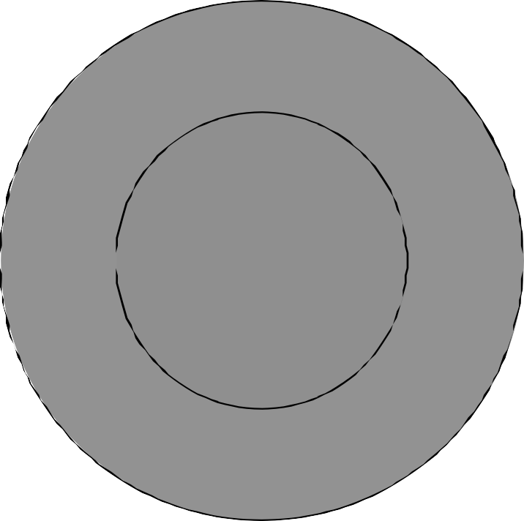
Image Evaluation and Archiving: Image Display
Display Field Of View (DFOV)
  30 cm
Scan Field Of View (SFOV)
  48 cm
48 cm
30 cm
60

Slide 60
Image Evaluation and Archiving: Image Display
Attenuation – CT Numbers
  Tissue controls the rate of attenuation

Slide 61
Image Evaluation and Archiving: Image Display
Attenuation – CT Numbers – aka Hounsfield numbers
Window Width – Image Contrast
Window Level – Image Brightness

Slide 62
Image Evaluation and Archiving: Image Display
Window Level and Window Width
Window Width
  WW on Image Contrast
    As the WW increases, the contrast decreases
    As the WW decreases, the contrast increases
    Contrast is optimized with medium WW settings
Window Level
  WL on Image Brightness

Slide 63
Image Evaluation and Archiving: Image Display
Cine
  Viewing images in a movie‐like fashion.
    Overlapping thin image sets are used
    Pro ‐ Increased spatial resolution
    Con – Increased dose to the patient

Slide 64
Image Evaluation and Archiving: Image Display
Geometric distance or region of interest (ROI) (e.g., mean, standard deviation [SD])
  Measurement tools to evaluate size or content of an anatomical structure or pathology.

Slide 65
Image Evaluation and Archiving
Image Display
Image Quality
  1. Spatial Resolution
  2. Contrast Resolution
  3. Temporal Resolution
  4. noise and Uniformity
  5. Quality Assurance and Accreditation
  6. CT Number (Hounsfield Units)
  7. Linearity
Artifact Reconstruction and Reduction
Informatics

Slide 66
Image Evaluation and Archiving: Image Quality
Spatial Resolution
  The ability to resolve closely placed objects that are significantly different from their background.

Slide 67
Image Evaluation and Archiving: Image Quality
Contrast Resolution
  Is the ability to differentiate a structure that varies only slightly in density from its surroundings.
  System sensitivity
    Low‐contrast sensitivity

Slide 68
Image Evaluation and Archiving: Image Quality
Temporal Resolution
  An indication of a CT system’s ability to freeze motions of a scanned object; performance parameter that deals in time or speed of data acquisition.
    Important parameter when you want to minimize motion.

Slide 69
Image Evaluation and Archiving: Image Quality
Noise and Uniformity
  Noise –a random variation in CT numbers caused by attenuation of the x‐ray beam as it passes through the anatomy of interest. Noise may also be caused by disturbances that interfere with the normal flow of data through pathways of computers and other electrical devices.
  Uniformity – the condition of being equal across all areas of a same tissue sample. For example, when you are doing a water phantom for QC and you take sample measurements at the center and along the periphery of the phantom all measurements will be within a set variance to be considered normal.
70

Slide 70

Image Evaluation and Archiving: Image Quality
Quality Assurance and CT Accreditation (ACR)
  QA is a program of Quality Control tests that periodically evaluate the performance of specific equipment. In this case CT equipment.
    There is a specific list of tests for CT equipment. This list displays the frequency of each test and the normal variance permitted.
    The 3 principles of a good QA program are;
      Regular performance of QC tests to insure accurate results
      Prompt interpretation of results
      Documented results with documentation of correction – if needed.
  Accreditation is a voluntary program that demonstrates to patients and personnel of the CT facility the safety and effectiveness of their C imaging services.
T

Slide 71
Image Evaluation and Archiving: Image Quality
CT Number (Hounsfield Units)
  CT numbers are based on the attenuation of x‐rays through a particular type of tissue.
  Hounsfield units are CT numbers!
    Godfrey Hounsfield created the numbered system to represent the attenuation energy received by the IR as x‐ray passed through a particular tissue.
    The first range was ‐500 for air, 0 for water, and +500 for bone.
    This was later changed to ‐1000 for air, 0 for water, and +1000 for bone – this is what we use today!

Slide 72
Image Evaluation and Archiving: Image Quality
Linearity refers to the linear relationship of CT numbers to the linear attenuation coefficients of the object to be imaged.

Slide 73
Image Evaluation and Archiving
Image Display
Image Quality
Artifact Recognition and Reduction
  1. Beam hardening or cupping
  2. Partial volume averaging
  3. Motion
  4. Metallic
  5. Edge gradient
  6. Patient positioning (out‐of‐field)
  7. Equipment induced
    Rings
    Streaks
    Tube arc
    Cone beam
    Capping
Informatics

Slide 74
Sources of Image Artifact
The patient
The imaging process
Equipment problems
  Malfunctions
  Imperfections
Technologist error

Slide 75
Beam‐Hardening Artifact
Appearance
  Dark bands or streaks
  Cupping at the center of the image
Cause
  Object size increases, low energy photons attenuated
  Radiation beams have different path lengths
Correction
  Filter
  Software

Slide 76
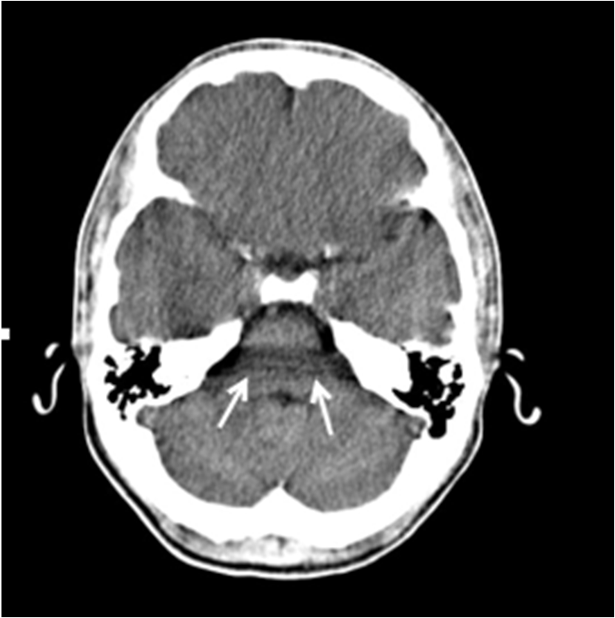
Image Evaluation and Archiving: Artifact Recognition and Reduction
Beam hardening or cupping

Slide 77
Partial Volume Artifact
Appearance
  CT number representing an object is false
Cause
  Object is not fully within a slice thickness
  Multiple objects in a slice
    CT number is an average of all tissue types within the slice
Correction
  Thinner slices
  Computer algorithms

Slide 78
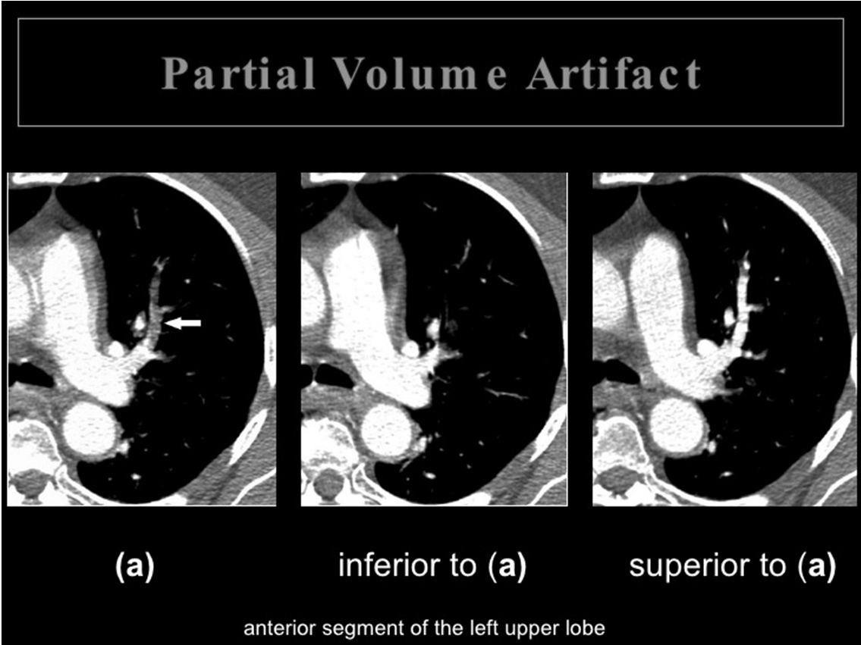
Image Evaluation and Archiving: Artifact Recognition and Reduction
Partial volume averaging
Image from Slide Share

Slide 79
Motion Artifact
Appearance
  Streaks
Cause
  Inability of reconstruction algorithm to account for inconsistencies
Correction
  Immobilize patient
  Short scan times
  Software
80

Slide 80
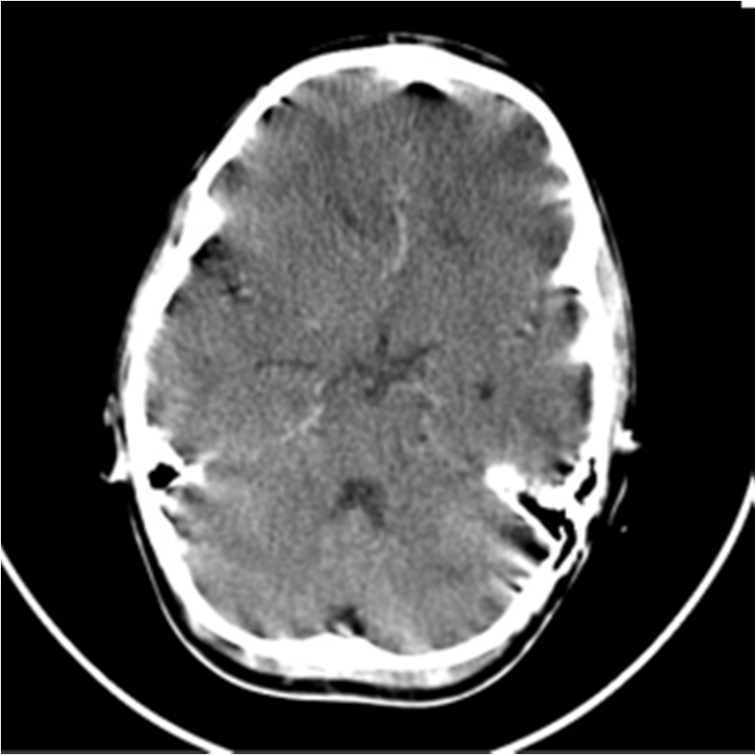
Image Evaluation and Archiving: Artifact Recognition and Reduction
Motion

Slide 81
Metallic Artifact
Appearance
  Streak and star‐shaped artifact
Cause
  Metallic object absorbs radiation, resulting in an incomplete projection profile
Correction
  Remove all metallic objects
  Software

Slide 82
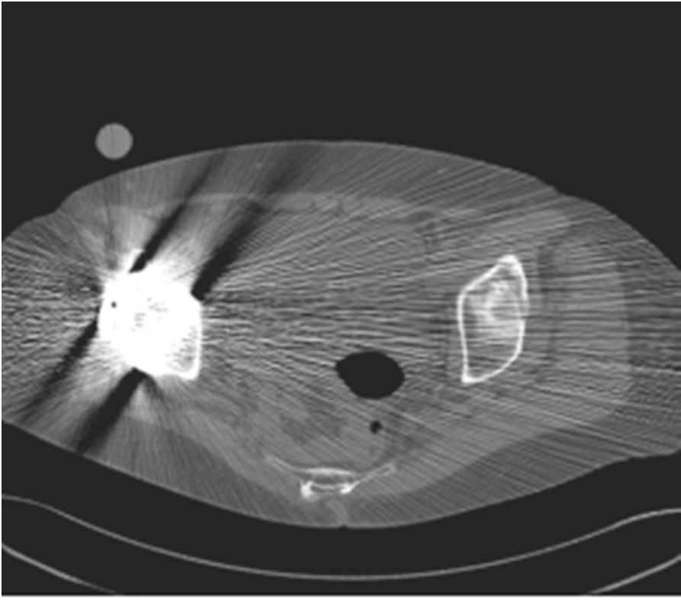
Image Evaluation and Archiving: Artifact Recognition and Reduction
Metallic

Slide 83
Edge Gradient Effect
Appearance
  Streaks
Cause
  Imaging an object that with an irregular shape or with a great difference in density
    Inconsistent attenuation information
Correction
  When applicable, over sample data beyond 360°
  Thinner slices

Slide 84
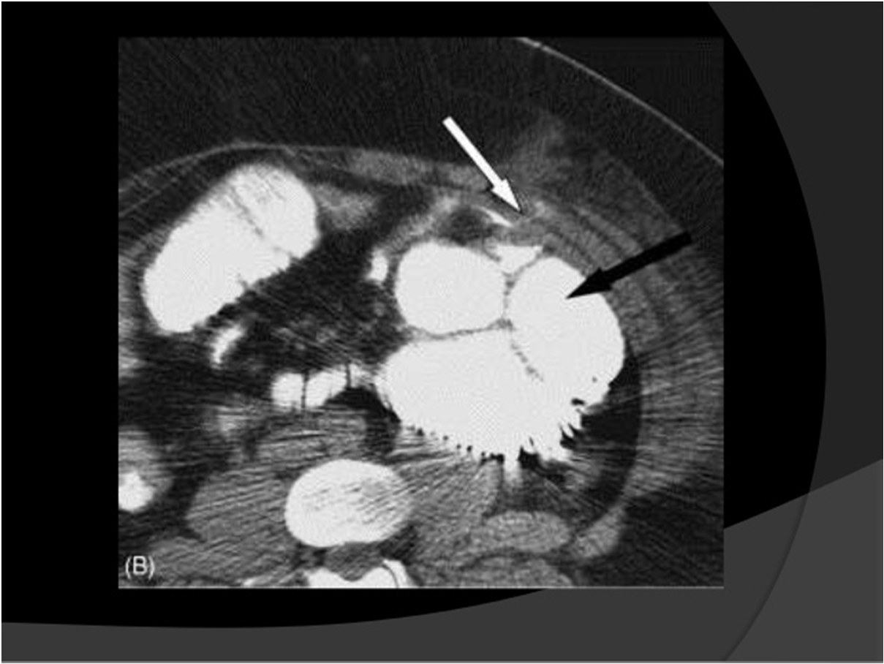
Image Evaluation and Archiving: Artifact Recognition and Reduction
Edge gradient

Slide 85
Out‐of‐field Artifact
Appearance
  Shading or streaking
Cause
  Anatomy out of the scan field of view contributes toward the attenuation and hardening of the x‐ray beam
Correction
  Ensure all anatomy is contained within SFOV
  Increase SFOV if possible

Slide 86
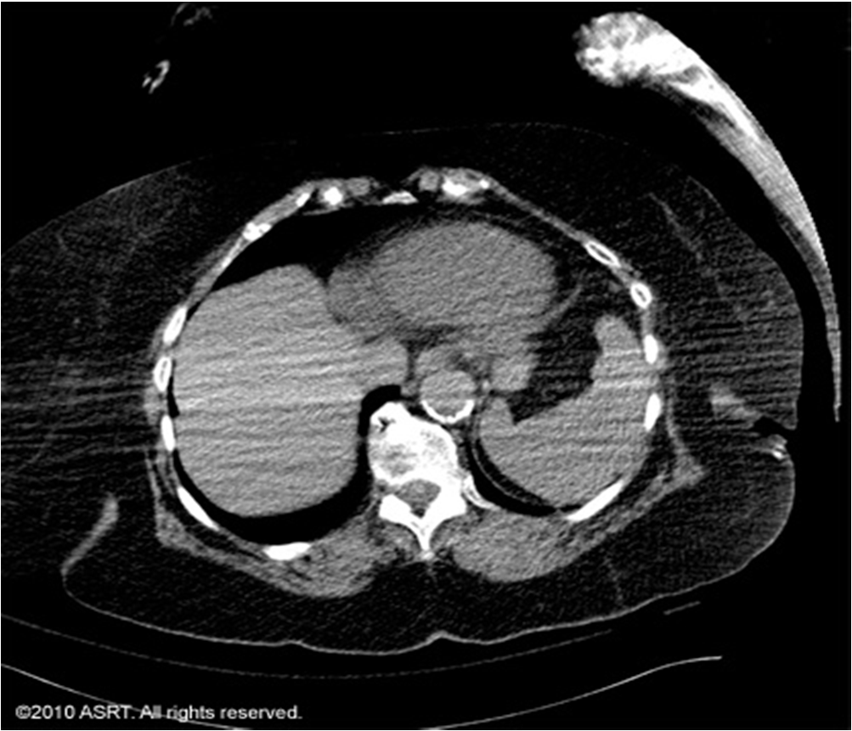
Image Evaluation and Archiving: Artifact Recognition and Reduction
Patient positioning (out‐of‐field)

Slide 87
Image Evaluation and Archiving: Artifact Recognition and Reduction
Equipment induced
  Rings
  Streaks
  Tube arc
  Cone beam
  Capping

Slide 88
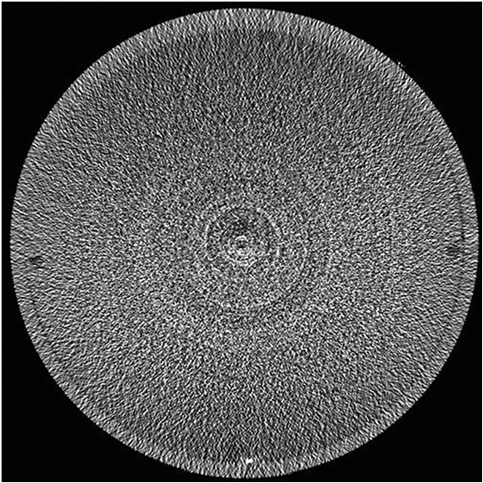
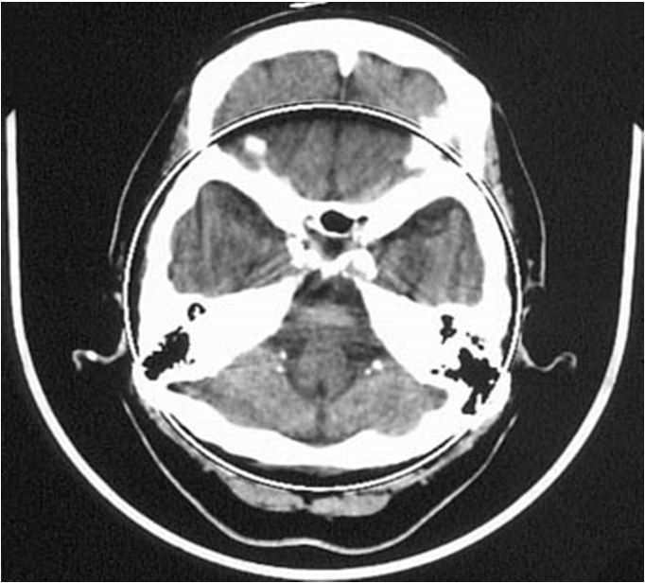
Image Evaluation and Archiving: Artifact Recognition and Reduction
Rings

Slide 89
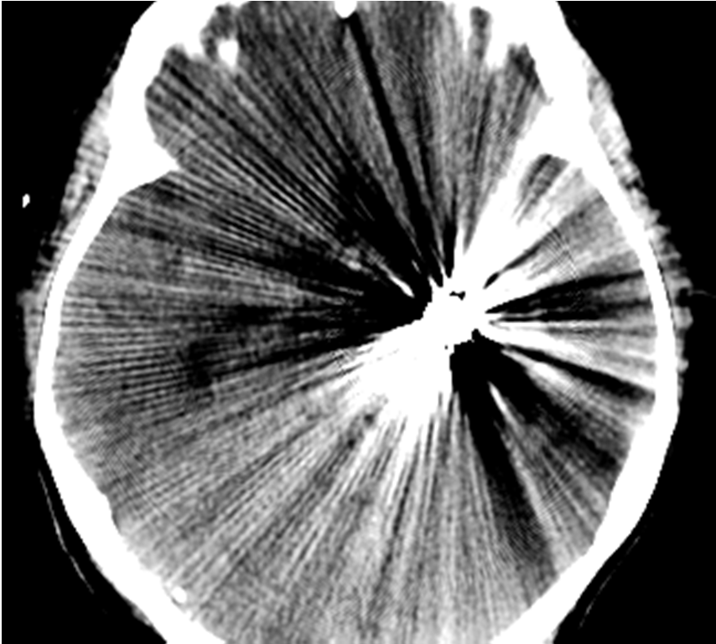
Image Evaluation and Archiving: Artifact Recognition and Reduction
Streaks
90

Slide 90
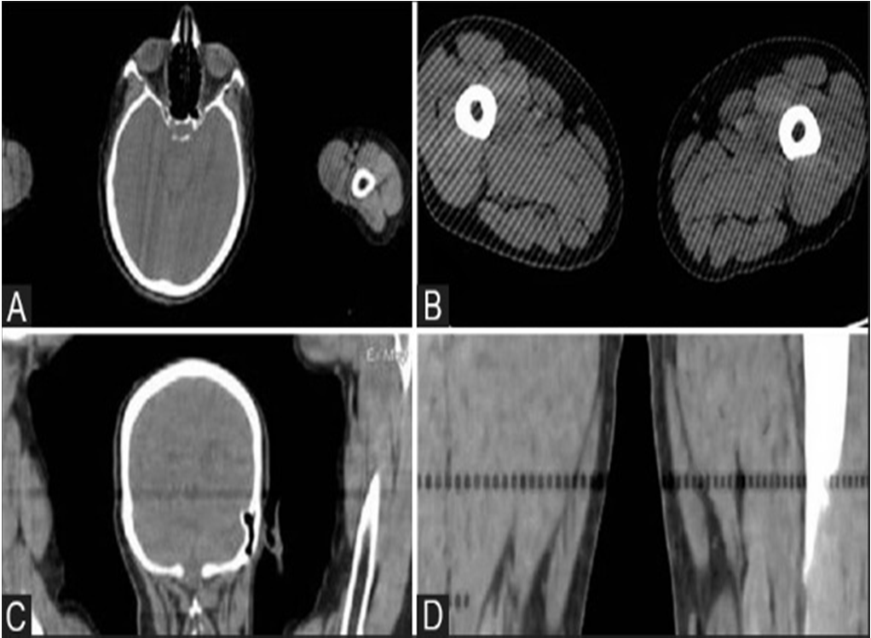
Image Evaluation and Archiving: Artifact Recognition and Reduction
Tube arc
Image is from the Indian Journal of Radiology and Imaging

Slide 91
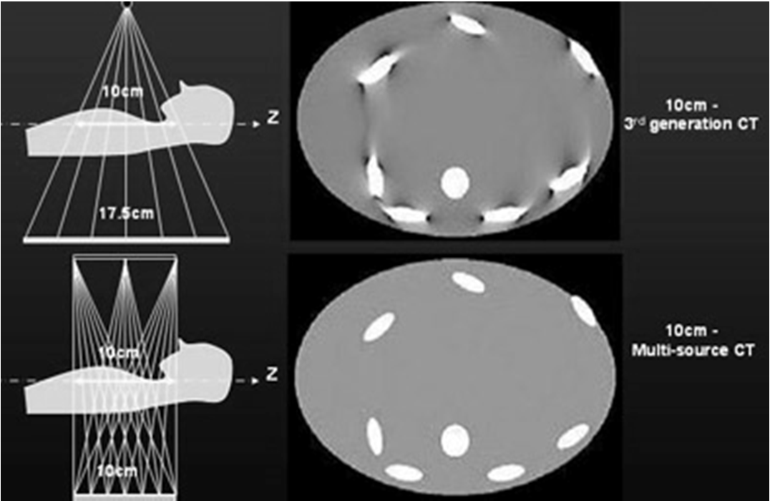
Image Evaluation and Archiving: Artifact Recognition and Reduction
Cone beam
Obtained from https://www.google.com/url?sa=i&rct=j&q=&esrc=s&source=images&cd=&cad=rja&uact=8&ved=2ahUKEw jPgrWP6OfaAhVL6YMKHXKFBJsQjB16BAgBEAQ&url=https%3A%2F%2Fwww.auntminnie.com%2Findex.aspx
%3Fsec%3Dlog%26itemID%3D76261&psig=AOvVaw3Wv8W0Cnven2REmotFQ3vt&ust=1525377448706539

Slide 92
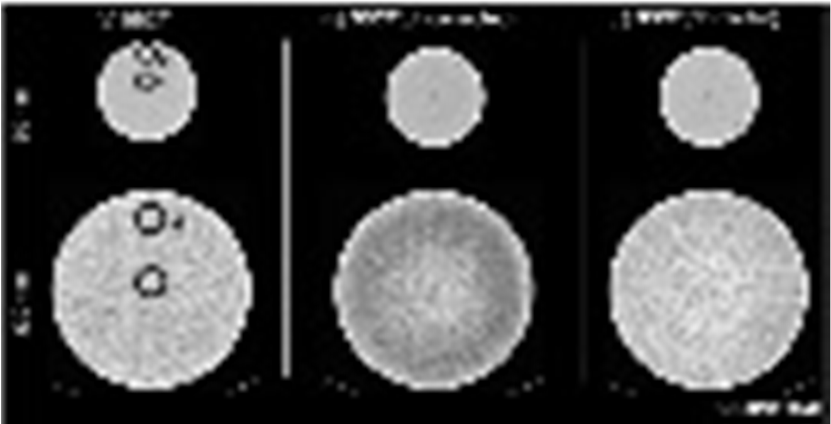
Image Evaluation and Archiving: Artifact Recognition and Reduction
Capping

Slide 93
Image Evaluation and Archiving
Image Display
Image Quality
Artifact Reconstruction and Reduction
Informatics
  1. Hard/Electronic Copy (e.g., DICOM file format)
  2. Archive
  3. PACS and electronic medical record (EMR)
  4. Security and confidentiality
  5. Networking

Slide 94
Image Evaluation and Archiving: Informatics
Hard/Electronic Copy (e.g., DICOM file format)
  Imaging facilities have large servers that store an electronic copy of all exams performed at that facility.
  DICOM is a special storage and sending format.
  DICOM
    D – Digital
    I – Imaging and
    CO – Communications in
    M ‐ Medicine

Slide 95
Image Evaluation and Archiving: Informatics
Archive
  Images are stored temporarily on the machine that acquired them.
  Images are then archived more permanently on CD’s, DVD‐R’s, and in the cloud.

Slide 96
Image Evaluation and Archiving: Informatics
PACS and electronic medical record (EMR)
PACS
  P – Picture
  A – Archiving and
  C – Communication
  S – System
EMR
  This is a secure medical record stored electronically of the patients health information.

Slide 97
Image Evaluation and Archiving: Informatics
Security and confidentiality
HIPAA
  H – Health
  I – Insurance
  P – Portability and
  A – Accountability
  A – Act
  HIPAA (Health Insurance Portability and Accountability Act of 1996) is United States legislation that provides data privacy and security provisions for safeguarding medical information.

Slide 98
Image Evaluation and Archiving: Informatics
Networking
  Network topologies
    Local Area Network – LAN
    Metropolitan Area Network – MAN
    Wide Area network ‐ WAN

Slide 99
100

