Slide 1
Patient Care and Safety

Slide 2
Learning Objectives
Perform accurate and complete clinical histories and obtain appropriate consent prior to performing a CT scan.
Identify lab values, medications, vital signs, and any other medical devices that are necessary for the patient prior performing a CT scan.
Determine proper administration and appropriate contrast media for the CT scan patient is receiving.
Assess the patient for any contraindications prior to contrast media delivery and for any adverse reactions after administering contrast media to a CT patient.
Determine the route(s) of contrast media for the CT scan performed.
Justify the radiation dose given to patients for specific CT scans and identify parameters that can lower radiation dose given to the patient.

Slide 3
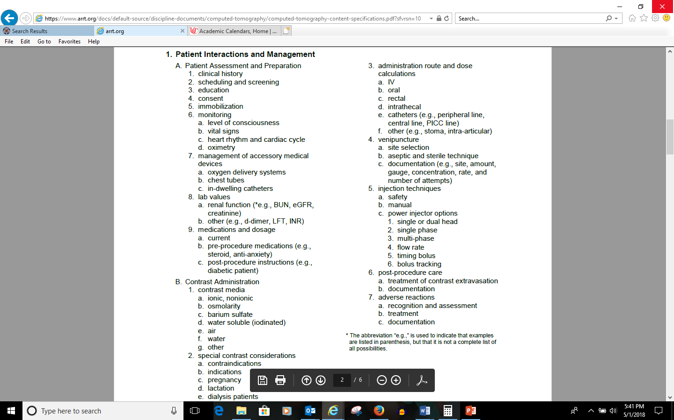

Slide 4
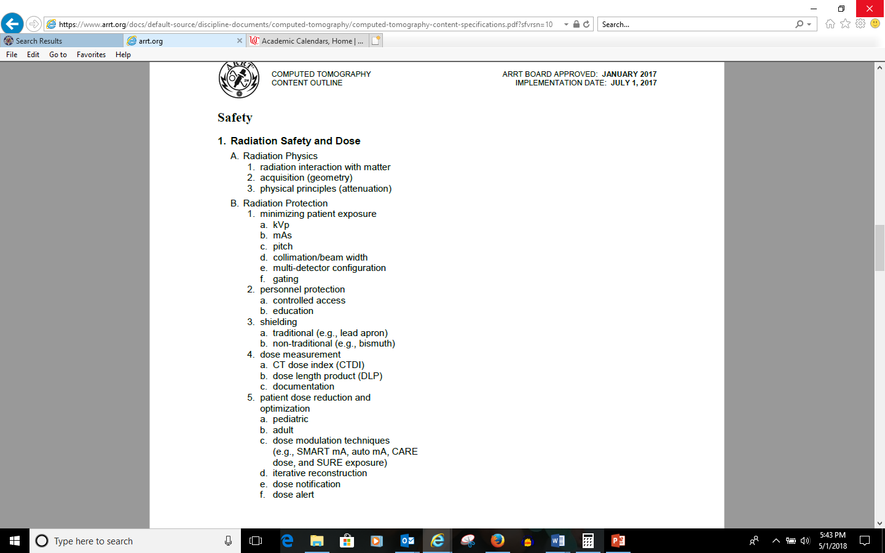

Slide 5
Patient Assessment and Prep
      Establish good rapport with patient
      Explain procedures clearly
      Encourage patients to ask questions
      Obtain detailed history from patient
      Make sure you are able to see and hear the patient at all times
      Patient understand importance of keeping still

Slide 6
Informed Consent
      Informed Consent: Full disclosure of facts (in understandable terms) which allow patient to decide
      Purpose of procedure
      Nature of procedure and technique to be used
      Potential risks and complications of procedure
      Hoped for benefits
      Alternative procedures
      Patient has ability to make decision
      If unable, then POA may consent
      If under 18, then parent/guardian consents
      EXCEPTION -- emergency circumstances

Slide 7
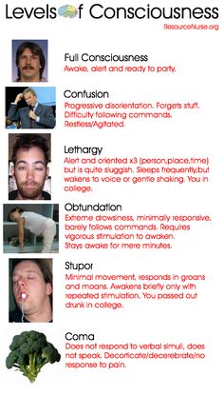
Patient Assessment
Monitoring
  Level of consciousness
resourcenurse.org/

Slide 8
Patient Assessment
Vital Signs:
                Temperature
                Pulse Rate
                Respiratory Rate
                Blood Pressure

Slide 9
Temperature
  Normal:
  97.7-99.5 ˚ (36.5-37 ˚ C)

Slide 10
Pulse Rate
Adult: 60-100 beats/minute on average
Pediatric: 70-120 beats/minute
Pulse Locations:
    Apical
    Radial
    Carotid
    Femoral
    Popliteal
    Temporal
    Dorsalis pedis
    Posterior tibial
    Brachial

Slide 11
Respiratory Rate
Respiratory Rate:
          Normal adult: 12 to 20 breaths/minute
          Child under 10: 20 to 30 breaths/minute
Medical Terms relating to breathing:
          Bradypnea - decrease in breathing
          Dyspnea - difficult breathing
          Tachypnea - rapid breathing

Slide 12
Blood Pressure
BP:
  Systolic:
      The highest pressure reached during contraction of the left ventricle of the heart as it pumps blood into the aorta.
      Normal ranges from 90 – 140 mm Hg
Diastolic:
      The lowest point to which the pressure drops during relaxation of the ventricles and indicates the minimal pressure exerted against the arterial walls continuously.
      Ranges from 60 – 90 mm Hg

Slide 13
ECG
ECG: Graphic record of electrical activity only
Tells nothing about pumping action
Electrodes sense electrical impulse from the skin
ECG machine records positive and negative impulses as positive (upward) or negative (downward) deflections on oscilloscope
Isoelectric line is the flat baseline = no impulses

Slide 14
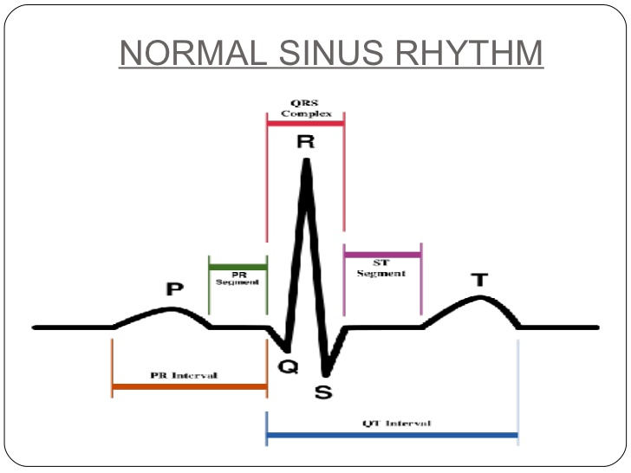
ECG

Slide 15
Pulse Oximetry
Pulse oximetry:
          adequate 95% - 100%
Saturation:
          test for measuring blood oxygen level; inadequate under 90%

Slide 16
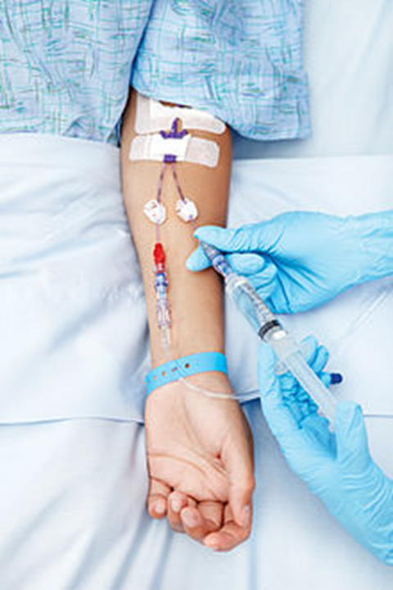
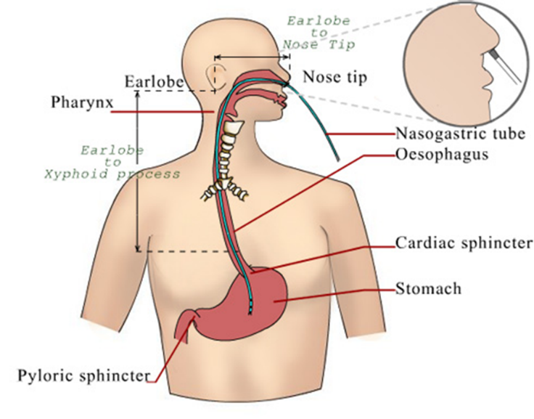

Management of Accessory Medical Device
  Oxygen delivery systems
  Chest Tubes
  In-dwelling catheters

Slide 17
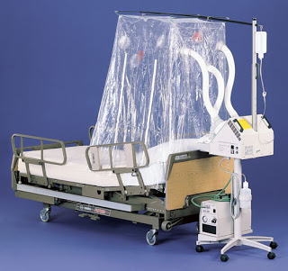
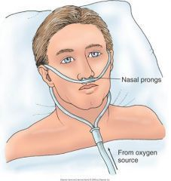
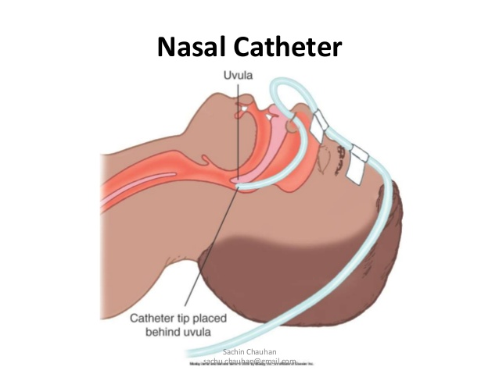
Oxygen delivery systems
Nasal cannula
Nasal catheter
Face mask
Nonrebreathing mask
Oxygen tent
Endotracheal
tube
http://respiratorytherapycave.blogspot.com/2011/12/no-more-mist-tents.html
http://dir.indiamart.com/impcat/disposable-cannulas.html?biz=30

Slide 18
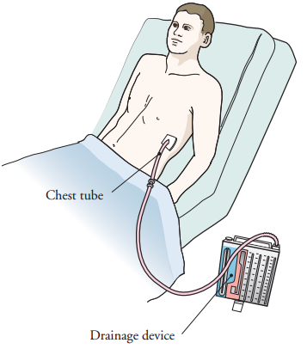
Chest Tubes
Medical terminology: thoracostomy tube
Purpose: drain the intraplueral space and the mediastinum
Placement: through the chest wall in the 5th and 6th intercostal spaces
Reasons: after cardiac surgery, pneumothorax or pleural effusions, empyema (pus)
https://www.mskcc.org/cancer-care/patient-education/about-your-chest-tube-placement

Slide 19
Urinary Catheter
Placed in the bladder to collect urine
Foley catheter vs. straight cathether
Below patients bladder

Slide 20
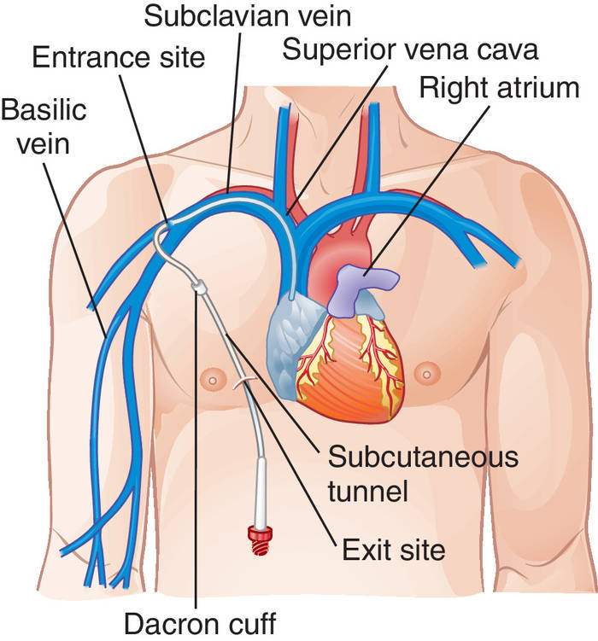
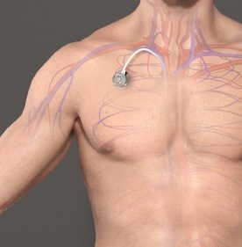
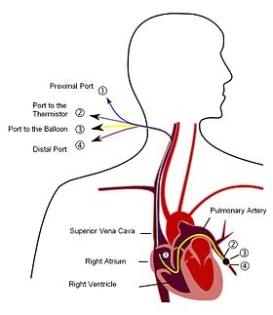
In-dwelling catheters
Central venous lines (CV)
  i.e. Hickman, Broviac, Groshong
Pulmonary artery lines (PA)
  i.e. Swan-Ganz
http://medical-dictionary.thefreedictionary.com/_/
http://www.nashvillevascularandveininstitute.com/port-a-cath-placement
https://en.wikipedia.org/wiki/Pulmonary_artery_catheter

Slide 21
Lab Values
Renal function
Blood Coagulation
  PT
  PTT
  Platelet
  INR
Other
  D-dimer
  LFT

Slide 22
Renal function
  BUN:
    healthy individuals is 7-20 mg/dL in adults, and 5-18 mg/dL in children
  eGFR:
    60 or higher is normal
  Creatinine:
    normal result is 0.7 to 1.3 mg/dL for men and 0.6 to 1.1 mg/dL for women
lifeoptions.org/kidneyinfo/labvalues.php
http://www.renal.org/information-resources/the-uk-eckd-guide/about-egfr#sthash.qgBmX6FR.dpuf
https://medlineplus.gov/ency/article/003475.htm

Slide 23
Chronic Kidney Disease
Stage 1
Stage 2
Stage 3a
Stage 3b
Stage 4
Stage 5
https://www.kidney.org/blog/kidney-cars/what-are-stages-chronic-kidney-disease. National Kidney Foundation

Slide 24
Blood Coagulation
PT: The prothrombin time (PT)—along with its derived measures of prothrombin ratio (PR) and international normalized ratio (INR)—are assays evaluating the extrinsic pathway of coagulation.
PTT: The partial thromboplastin time (PTT) is used in conjunction with another measure of how quickly blood clotting takes place called the prothrombin time (PT). The prothrombin time measures the speed of clotting by means of the extrinsic pathway (also known as the tissue factor pathway). Monitoring effects of heparin
Platelet: Platelets, also called thrombocytes are a component of blood whose function (along with the coagulation factors) is to stop bleeding by clumping and clotting blood vessel injuries
INR:INR in absence of anticoagulation therapy is 0.8-1.2. The target range for INR in anticoagulant use (e.g. warfarin) is 2 to 3.

Slide 25
Medications and Dosage
Current Reconciliation
Pre-procedure medications (steroid, anti-anxiety)
Post-procedure instructions

Slide 26
Contrast Administration
Ionic/nonionic
Osmolarity/Osmolality
Barium sulfate
Water-soluble
Water
Other-neutral

Slide 27
Contrast Administration
ACR: 4 H’s
Physiologic and pathologic processes
Special Contrast Considerations:
    Break-through Reaction
    Contraindications
    Indications
    Pregnancy
    Lactation
    Dialysis patients

Slide 28
4 H’s
History
Hydration
Have equipment and Expertise Ready
Head’s Up

Slide 29
Physiologic and Pathologic Processes
Asthma
Enviromental/food allergies
Renal disease
Multiple Myeloma
Diabetes Mellitus
Pheochromocytoma
Sickle Cell disease
Hyperthyroidism
Significant cardiac disease
Anxiety

Slide 30
Administration Routes
IV
Oral
Rectal
Intrathecal
Catheters
Other

Slide 31
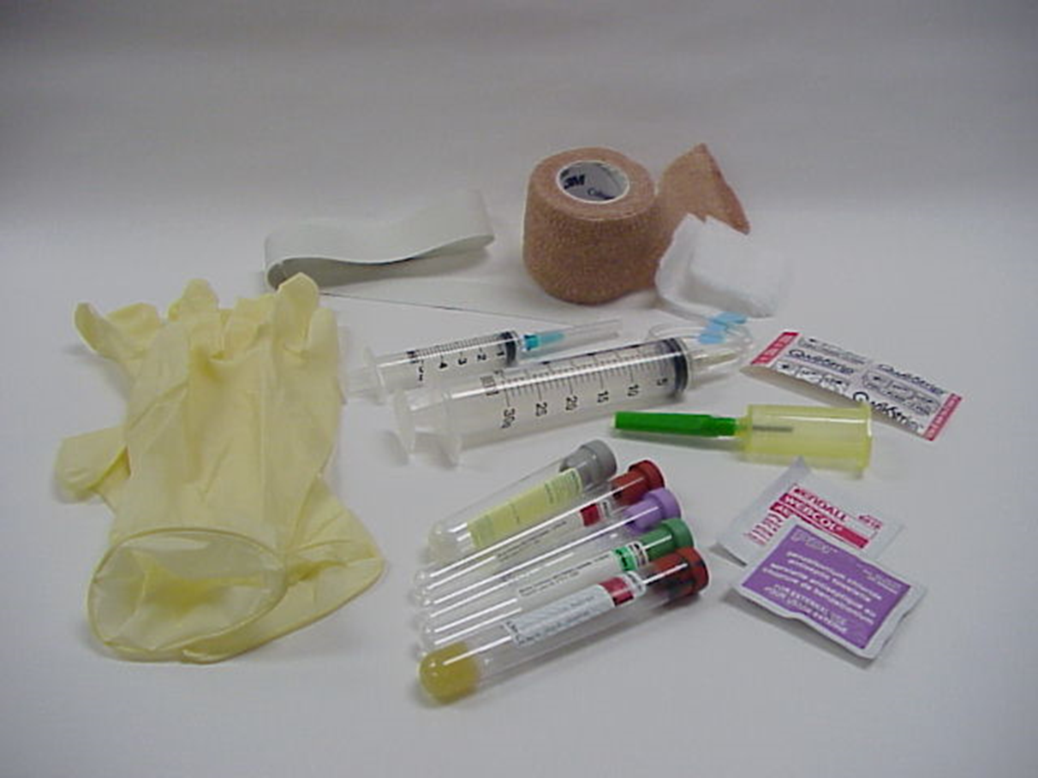
Venipuncture
Figure 10-06 The “head” and “body” CT scanner dosimetry phantoms are solid acrylic with holes placed strategically to receive a pencil ionization chamber. Although the phantoms differ in diameter, they are both 15-cm long.

Slide 32
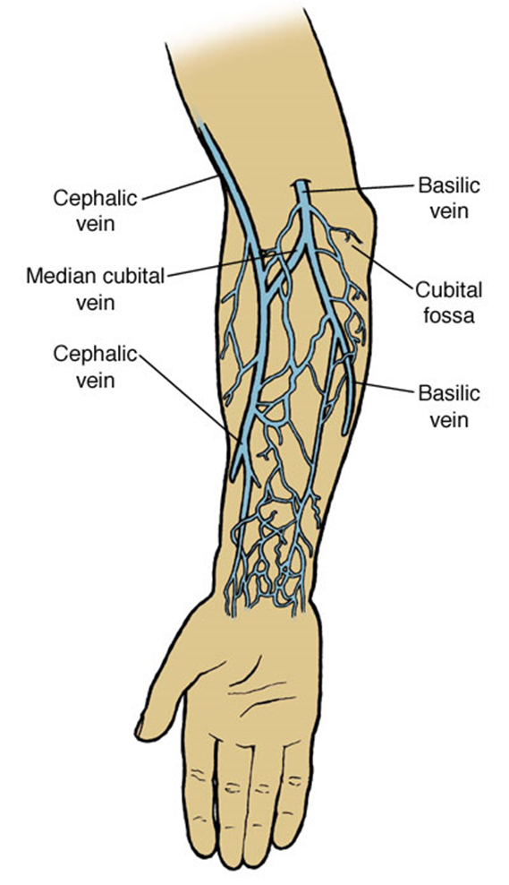
Venipuncture
Cephalic vein – lateral forearm
Basilic vein – medial forearm; largest diameter of antecubital veins
Median cubital vein - passes from lateral to medial across the antecubital fossa; connects the cephalic & basilic veins; most commonly used for venipuncture

Slide 33
Venipuncture
Prior to injection check:
- any previous history of allergy
- patient height & weight
- renal, liver and cardiac function
- patient medication/drug history
Set up all needed equipment – even emergency equipment should be close by
Preliminarily select venipuncture site

Slide 34
Venipuncture
Wash hands and put on gloves
Apply tourniquet around arm 3-4 inches above venipuncture site. Do not leave tourniquet on the arm for more than 1-2 minutes.
Select venipuncture site
Cleanse venipuncture site w/ antiseptic, usually betadine or 70% isopropyl alcohol, using circular motion towards the periphery. Allow area to dry before proceeding.

Slide 35
Venipuncture
Grasp patient's arm firmly, placing the thumb 1-2 inches below the chosen site to draw skin taut. This will anchor the vein.
Perform venipuncture keeping bevel side of needle up.
Align needle bevel up
Pierce skin at a 15-30 degree angle
Decrease angle until parallel to skin surface, then pierce vein
If needle is withdrawn above skin surface, do not attempt venipuncture again with same needle

Slide 36
Venipuncture
Grasp barrel of syringe firmly and pull firmly on plunger until required amount of blood is in the syringe
Ask patient to open fist and remove tourniquet as soon as desired amount of blood has been obtained. Remember not to release tourniquet until blood collection is completed. Release tourniquet before injecting contrast media.

Slide 37

Immediately after the needle is removed from the vein, apply direct pressure with gauze to puncture site for a few minutes.
Check site for bleeding or swelling. If site is still bleeding, continue direct pressure. Do not bandage until bleeding has completely stopped. Once bleeding has stopped, apply bandage over the gauze pad at site. Advise patient to leave bandage on for at least 15 minutes.

Slide 38
Injection Techinques
Manual
Power injector
    Single or dual head
    Single phase
    Multi-phase
    Flow rate
    Timing bolus
    Bolus tracking

Slide 39
Adverse Reactions
Mild:
Signs and symptoms self-limiting
Urticaria
Cough
Sweats
Nausea/Vomiting
Notify physician immediately
Treatment: Antihistamine delivered, observation of patient

Slide 40
Extravasation
Is the leakage of a fluid out of its container. In the case of inflammation.
Catheter removed immediately
Pressure
Warm compress

Slide 41
Adverse Reactions
Moderate:
  Signs and symptoms are more pronounced. Moderate degree of clinically evident systemic signs
  Hypertension
  Tachycardia
  Dyspnea
  Prompt treatment. Careful observation for possible progression to life-threatening event

Slide 42
Adverse Reactions
  Severe:
  Signs and symptoms are life-threatening
  Laryngeal edema
  Hypotension
  Convulsions
  Unresponsiveness
  Treatment: Prompt recognition and aggressive treatment

Slide 43
Adverse Reactions
Anaphylactic Shock:
  A massive allergic reaction
  Vasogenic shock
  Adrenaline (epinephrine) is often administered
  Observe for bronchoconstriction
Patients with cardiac arrest should be treated with CPR

Slide 44
Adverse Reactions
Anaphylactic Shock:
Treatment/Management
Screen for allergies
Administer meds (often benadryl, epinephrine, corticosteroid) and fluids
Document

Slide 45
Adverse Reaction Rates
70% in first 5 minutes
16% after 5 minutes
14% after 15 minutes
Dose relation to toxicity is unpredictable

Slide 46
Contrast-Induced Nephrotoxicity
(CIN)
Delayed effect of contrast agent administration
Increase in creatinine level
Pre-exsisting renal function
Factors
  Diabetes
  Myeloma
  Advanced age
  Cardiovascular disease

Slide 47
Safety

Slide 48
Radiation
Interaction with matter
Acquisition (geometry)
Physical Principles (attenuation)

Slide 49
Radiation Safety and Dosimetry
Factors affecting dose:
  Direct
  Indirect

Slide 50
Exposure Technique Factors
Kilovoltage (kVp)
Milliamperage (mA)
  Constant
  Effective
Time (s)
Automatic Exposure Control/Modulation

Slide 51
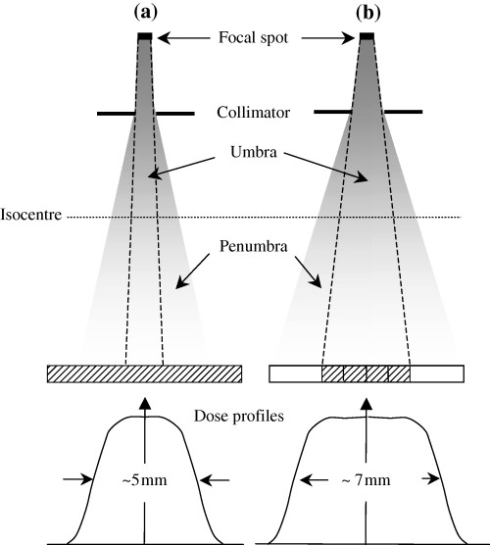
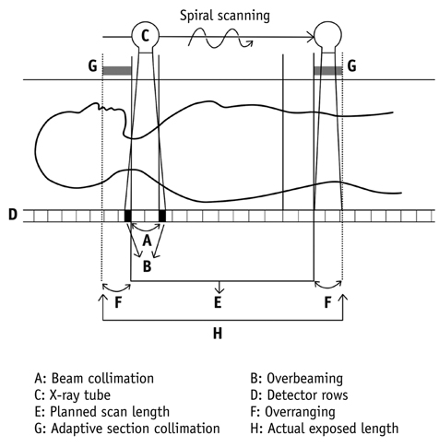
Exposure Technique Factors, cont.
Collimation
Pitch
Number of Detectors
Over-ranging (Z-overscanning)
Patient Centering
www.researchgate.net-
https://synapse.koreamed.org/DOIx.php?id=10.3348/kjr.2012.13.1.1&vmode=PUBREADER#!po=4.54545

Slide 52
Iterative Reconstruction Algorithms
Reduced noise and minimize the higher radiation dose inherent in the filtered back projection.
All manufactures offer IR algorithms
Assumption

Slide 53
Gating
Cardiac studies
Prospective gating

Slide 54
Personal Protection
Controlled access
Education
Guardian/family member
Best practices in protocol optimization

Slide 55
Dose Reduction and Optimization
ALARA
Radiation protection principles
Early dose optimization strategies
Pediatric/Adult
  Image Gently/Image Wisely
  Examinations are needed-communication between ordering physician and radiologist
Dose notification
Dose alert
Techniques:
  SURE exposure, Smart mA, CARE dose, auto mA

Slide 56
The role of the CT Technologist
Technologist careful attention when optimizing an scan:
  Risks of radiation and CT dose in particular
  Current technical advances in CT
  CT dose metrics CTDI, DPL
  CT image quality metrics, spatial resolution, contrast resolution, noise and artifacts
  CT patient dose: exposure factors, IR algorithms, anatomical coverage, etc.
  Scan protocols and reviewing protocols with radiologist ongoing basis with the goal of scan optimization and image quality.
  Pre and post scan CTDI and DPL reports
  Getting involved in CT dose monitoring within the department
  Participating in research on CT patient dose and image quality optimization
  Continuous professional development.

Slide 57
Dose Measurement
Slice sensitivity profile (SSP)
  Exposure vs. absorbed dose
  Kerma

Slide 58
Dose Measurement
CT Dose Index
  Approximate measure of the dose received in a single CT section or slice
  Calculated for central slice and seven slices on each side
  Mean absorbed dose in scanned object volume

Slide 59
Dose Measurement
Dose Length Product
  CT dose descriptor that provides a measurement for the total amount of exposure for a series of scans
  Calculated DLP=CTDI_{volume} X Scan length

Slide 60
Dose Measurement
Multiple Scan Average Dose (MSAD)
  Controlled by pitch
  Decreases when slice thickness is less than bed index
  Accurate at the center of scan series
MSAD=T/I x CTDI
  T=Slice thickness
  I=increment or imaging space

Slide 61
Dose Check
Dose notification
Dose Alert

Slide 62
Shielding
Lead shielding:
  Out-of-plane
    Protect patients and personnel from radiation exposure
    During CT most exposure comes from internal scatter and not primary beam (unless gonads are being examined)
    Place gonadal shielding to alleviate fears of patient
    Can be used to protect eyes, breast, and thyroid

Slide 63
Shielding
  Bismuth:
  In-plaine sheilding
    Research has shown to reduce dose to anterior organs
    Several disadvantages especially when using AEC such as unpredictable and potentially undesirable levels of dose and image quality and degrade image quality
      Streaking artifact

Slide 64
References:
Adler, A. MEd. RT (R), FAEIRS and Carlton, R. MS.RT (R), (CT),FAEIRS 2012. Introduction to Radiologic Sciences and Patient Care. Elsevier 5th Ed.
Seeram, Euclid, 2016. Computed Tomography Physical Principles, Clinical Applications, and Quality Control. Elsevier, 4th Ed.
Demaio, D. MEd. RT ( R), CT 2018. Mosby’s Exam Review for Computed Tomography. Elsevier. 3rd ed.

