Slide 1
CT of the Body and Special CT Procedures

Slide 2
Objectives
Determine specific imaging plane used to acquire or reformat CT scan, i.e. sagittal, coronal, transverse, and off-axis or oblique.
Assess and evaluate CT scans for use of contrast media.
Differentiate between normal anatomy and pathological processes.
Critique CT scan for proper positioning, acquisition methods, parameter selections, and any protocol modifications.
Explain the technical applications for special procedures in CT such as, cardiac, fluoroscopy, virtual colonography, and radiation planning.
Explain the techniques used to construct 3-D images from an axial CT scan.
Describe the different classifications for 3-D imaging in CT.
Identify the advantages and limitations for virtual reality imaging.
Explain the technical applications for special procedures in CT such as, cardiac, fluoroscopy, virtual colonography, and radiation planning.
Explain the techniques used to construct 3-D images from an axial CT scan.
Describe the different classifications for 3-D imaging in CT.
Identify the advantages and limitations for virtual reality imaging

Slide 3
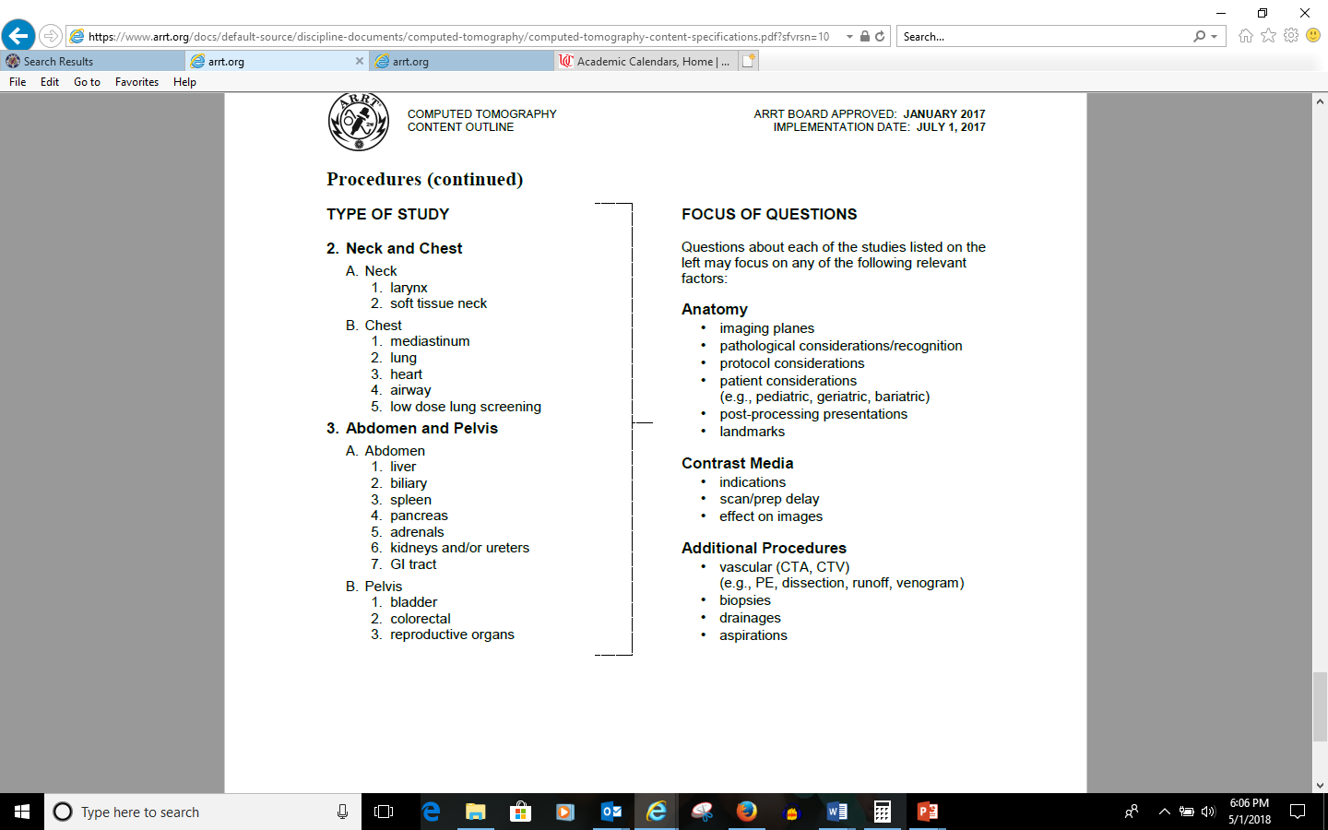

Slide 4
Neck

Slide 5
Chest

Slide 6
Clinical Indications
Abdominal pain
Mass
Diverticulitis
Liver
Spleen
Bowel
Retroperitoneum
Pelvis
Trauma
Vascular system
Interventional applications
Musculoskeletal system
Notes:
Liver-IV contrast medium is important for detecting focal masses in the liver. Triphasic (arterial, venous, and delayed scan) examinations are possible through bolus tracking to determine metastases vs hemangiomas. Dynamic CT scanning involves multiple repeat scans at the same level or several selected levels and can help to demonstrate the characteristic enhancement pattern of hemangiomas. CT angiography can also be used to assess the hepatic portal vein. U/s is still one of the leading methods of evaluating the liver. Scanning with thinner slices 2.5mm through the entire liver has shown to be effective in detecting tumors and planning tumor resection. The liver is the 2nd most common solid abdominal organ to be injured due to blunt trauma. Contrast enhanced CT can identify hematomas that may be of subcapsular or parenchymal lacerations, which could mean the presence of a more severe vascular injury involving the vena cava, portal veins, or hepatic artery.
Spleen-most commonly injured abdominal organ in the abdomen and trauma the most common indication. Contrast enhanced can help to diagnose the principal type of injury, hematoma, laceration, and vascular injury.
Bowel- CT can delineate the bowel wall and the lumen of the bowel, it also can allow for virtual colonoscopy in the diagnosis of polyps. Oral contrast help to identify patients with inflammatory bowel diseases. CT has not proven very accurate for staging GI malignancies, it is still widely used for that purpose. CT can confirm an obstruction, determine the level and perhaps the cause and even indicated whether vascular compromise is present. Diagnosis of appendicitis
Retroperitoneum-Pancreas-Acute pancreatitis is a clinical diagnosis and normally CT nor U/s is necessary, only preformed if other test are uncertain; preferred mainly because of the incident findings of paralytic ileus or larger pseudo cysts providing better delineation and extent of involvement. Biphasic and triphasic examinations for identifying lesion
kidneys- more sensitive in detecting stones associated with obstruction and aids in treatment planning and can determine mass vs. cyst. Can detect renal colic which was previously identified by using conventional IVU procedures. CT useful for preoperative staging and restaging for detecting reoccurrences. Polycystic kidneys demonstrate a higher attenuation consistent with a diagnosis of an infected cyst or bleeding into a cyst. Preoperative assessment of renal donors with 3 D CT CTA studies provides the surgeon with a very graphic road map that demonstrates the number and location of renal arteries.
adrenal glands-pheochromocytomas and tumors causing Cushing and Conn syndromes larger that 5mm can be seen on CT
Extremely thin patients hard to delineate healthy adrenal glands.
Pelvis-trauma and tumor staging
Trauma- integral component of the assessment of blunt abdominal and chest trauma full body completed in minutes, MPR very useful in trauma imaging of the body.
Vascular system-aortic dissection, coronary arteries, pulmonary arteries, renal arteries, and abdominal aortic aneurysms.
Interventional- abscess drainage and biopsies
Musculoskeletal system-bony tumors skeletal trauma

Slide 7
Preparing the Patient
Obtain clinical history
Check allergies/lab values
Remove all metal objects from the chest down through pelvis

Slide 8
Abdomen and Pelvis Positioning
Place the patient supine on the table
Patient feet or head first will depend on the protocol of the facility
Patient’s arms need to be raised above the head
Notes:
Why do we raise the patient’s arms (if possible) above the head?
Why is it important to ensure the patient is centered A to P in the scanner before doing the localizer? Is positioning the patient S to I as important? Why or why not? Bisect midcoronal plane

Slide 9
Routine
Scout
Breath hold
Radiopaque objects removed
Patient is straight
Notes:
Scout needs to cover entire abdomen and/or pelvis. To ensure that all the liver is covered, starting the scout scan around the axilla is sufficient. The scan can be stopped when you reach the end of your scanning area. It is always a good idea to start 1-2 scans higher due to different breath holds.
If the pelvis is the included make sure you have the patient you include anatomy through the symp.
Inspiration vs. expiration –prepare patients for the breath hold during the scan its self—depending on pitch, slice thickness, area covered, detector array, how long the breath hold might be. A and P usually about 15 seconds

Slide 10
Abdomen/Pelvis
Communicate importance of the breath hold throughout the scan
Scan field of view (SFOV) vs. display field of view (DFOV)
Scan range
Gantry angle
120 kVp
200-250 mAs
Slice thickness
Notes:
Breath hold misregistration of anatomy and motion eliminated
Coaching-high quality images
SFOV for the body usually at 50 cm-do not change the SFOV
Make DFOV the smallest possible, but you do need to include soft tissue at the periphery of the patient—again breath holds can make a difference. Institutional protocol-use the same every time you scan a patient
Scan range-above the dome of the liver ensuring all major organs are included
mA dose modulation software-according to patient,i.e. peds patient.
Slice thickness 5 mm
Slice interval: 5mm

Slide 11
Abdomen/Pelvis
Pitch
Standard or soft tissue algorithm
WW 350-400
WL 40-60
Matrix 512 x 512
Notes:
Pitch between .56 and 1.2
Standard or soft tissue algorithm

Slide 12
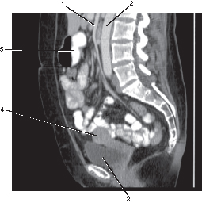
Abdomen/Pelvis
Annotate
Single vs. Multiphase
Reconstruction
Notes:
Annotate-contrast, no contrast, delayed
Multiphase-tailored to individual organs-liver, kidneys, pancreas, etc.
Reconstruction 3-5 mm thickness routinely, again organ specific adrenal glands less and facility protocols.
Sagittal and coronal in addition to the axial images

Slide 13
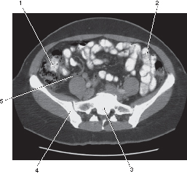
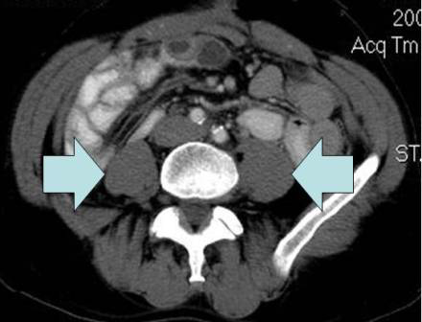
Abdomen/Pelvis
Contrast
  Oral
  IV
Notes:
Oral-gastroinstestional tract-drink before arriving for the exam allow to be fully opacified
IV-injected 2-3 mL/second usually 100-150ml to opacity blood vessels and organs.
can be based on weight-i.e. peds
Delay: 65-70 seconds post injection, pelvis only it is 90 secs.

Slide 14
Post scan
Check for motion
Image quality

Slide 15
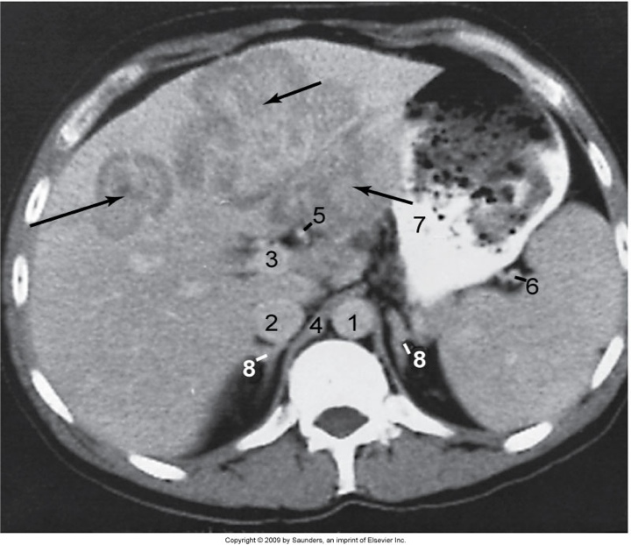
Liver
Figure 18-7 Hepatoma (arrows) involving the lateral and medial segments of the left lobe of the liver. 1, Aorta; 2, inferior vena cava; 3, portal vein; 4, crus; 5, hepatic artery; 6, splenic artery; 7, stomach; 8, adrenals.

Slide 16
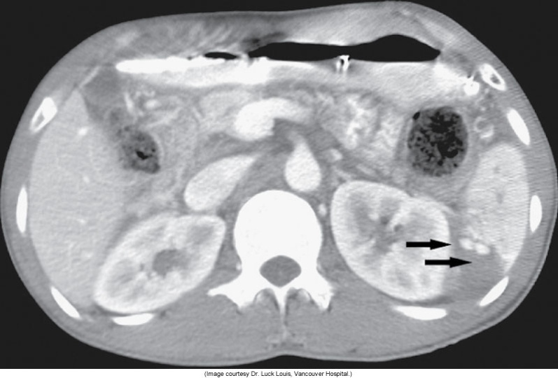
Splenic Rupture
Figure 18-10 Splenic rupture with pseudoaneurysms (arrows). (Image courtesy Dr. Luck Louis, Vancouver Hospital.)

Slide 17
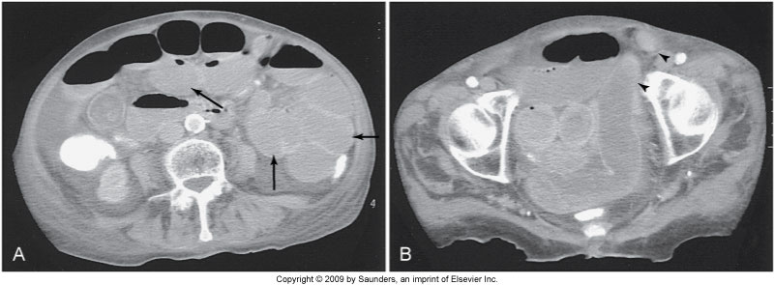
Small Bowel Obstruction
Figure 18-11 A, Small bowel obstruction as evidenced by the multiple dilated loops of proximal small bowel (arrows). B, A herniated loop in the left groin (arrowheads).

Slide 18
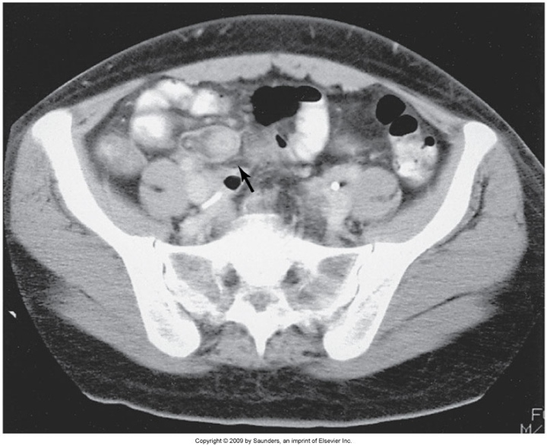
Appendicitis
Figure 18-12 Thickened, inflamed appendix (arrow) in the right lower quadrant.

Slide 19
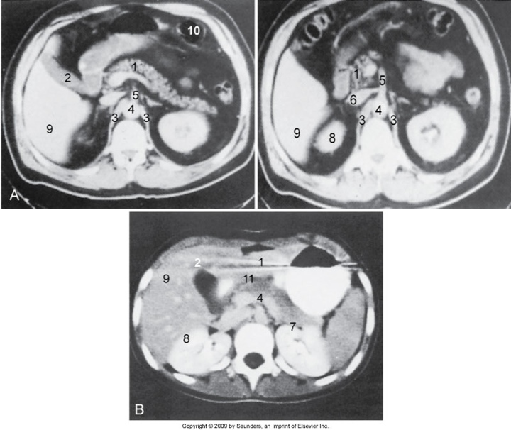
Pancreas
Figure 18-13 Normal pancreas in patient with abundant (A) and little (B) intra-abdominal fat. 1, Pancreas; 2, gallbladder; 3, crus of the diaphragm; 4, aorta; 5, superior mesenteric artery; 6, inferior vena cava with left renal vein; 7, left kidney; 8, right kidney; 9, liver; 10, bowel; 11, splenoportal confluence.

Slide 20
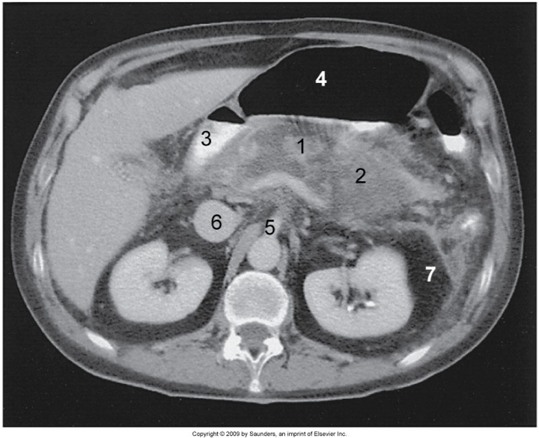
Acute Pancreatitis
Figure 18-14 Acute pancreatitis. Necrotic pancreas (1) surrounded by fluid (2), duodenum (3), air-filled stomach (4), superior mesenteric artery (5), inferior vena cava (6), and perirenal fat (7).

Slide 21
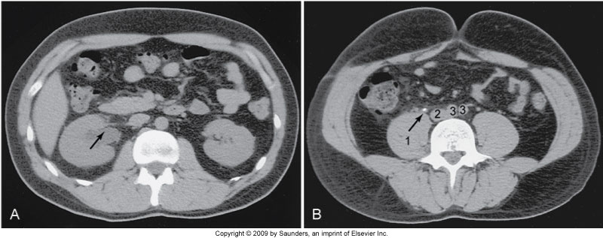
Renal Pelvis
Figure 18-17 A, Dilated right renal pelvis (arrow). B, Calculus (arrow) in the right ureter. 1, Psoas muscle; 2, inferior vena cava; 3, iliac arteries.

Slide 22
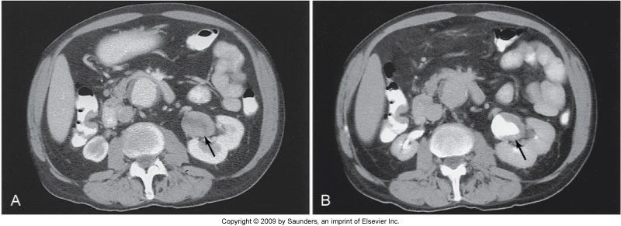
Renal Mass
Figure 18-18 Solid mass in the renal pelvis (arrow) before (A) and after (B) contrast opacification of the renal pelvis.

Slide 23
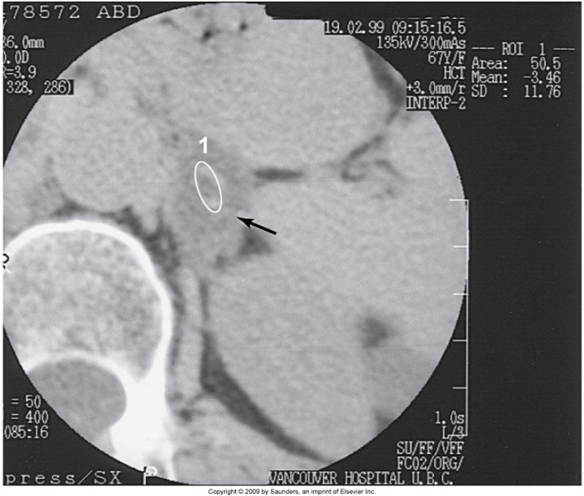
Adrenal Mass
Figure 18-19 Region of interest within an adrenal mass (arrow) indicating a negative Hounsfield number, confirming the diagnosis of adenoma. 1, Left kidney; 2, aorta.

Slide 24
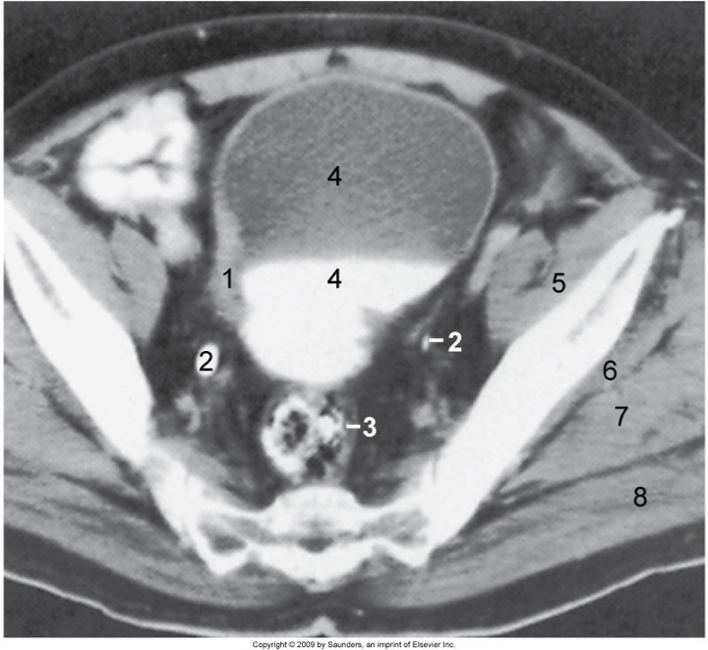
Imaging of the Pelvis
Figure 18-22 Thickening of the bladder wall without evidence of extension into the perivesical fat (proven amyloidosis). 1, Thickened bladder wall; 2, ureters; 3, sigmoid colon; 4, urine and contrast medium in the bladder; 5, iliac muscle; 6, gluteus minimus; 7, gluteus medius; 8, gluteus maximus.

Slide 25
CT Fluoroscopy
Interventional guidance tool
CT fluoroscopy fundamentals
Equipment configuration and data flow
X-ray technique parameters
Image quality and radiation dose considerations
Notes:
Real-time depends on slip ring technology, high speed processing of data collected from the patient, and a fast processing algorithm from image reconstruction. Guidance tool in interventional radiology.
Based on continuous scanning, fast image reconstruction, and continuous image display
Patient doesn’t move during continuous rotation of the x-ray tube, data is collected after one rotation 360 degrees the first image is displayed on the monitor for viewing. Images are displayed every time a data set is collected for 60-degree rotation. 6 images/sec can be displayed.
Made possible by a set of hardware components dedicated to provide fast computations, together with a new image reconstruction algorithm. The interpolation algorithm used in spiral/helical CT scanning is not used. Image reconstruction algorithm used removes artifacts resulting from the simultaneous movement of the patient through the gantry while the x-ray tube rotates continuously during data acquisition. Motion artifacts are present.
Hardware components such as fast arithmetic unit, high speed memory, and back-projection gate array. Parallel processing of the data is integral element of real-time CT fluoro
Data acquisition components: slip-ring, variable FOV, scanner (x-ray tube, detectors, and associated electronics) generator is a high frequency. Raw data acquired then sent to a preprocessor and then to the high-speed memory (processed using convolution and back projection other data is processed using real-time reconstruction data. Control console allows technologist to have full control of the table movement through the gantry, to vary the height of the tabletop, and tilt the gantry.
Technique parameters-30-50mAs and tube voltages of 80-120 kVp. Special filter introduced into the dose to the patient. Dose reduction depends on the type of scanner and the exposure parameters used during the examination. Variable slice widths and FOV.
Image quality spatial resolution, density resolution, image noise, and artifacts. Radiation dose consideration length of time of exposure, dose is directly proportional to exposure time. Scatter radiation distribution (image 13-8). Wearing a protective lead, including aprons, glasses, thyroid shields which should be at least .5 mm lead equivalent.

Slide 26
Test your knowledge?
Which of the following influences the spatial resolution in cardiac CT?
Detector size
Reconstruction interval
Pitch
All the above
Notes:
All of the above

Slide 27
Test your knowledge?
Which of the following is defined as a CT image of the blood vessels opacified by contrast media?
CTA
MRA
CT endoscopy
Virtual endoscopy
Notes:
A

Slide 28
Test your knowledge?
The following are crucial steps in carrying out a CTA examination except:
The patient must be placed in the supine position
Patient preparation and acquisition parameters
Contrast media administration
Image postprocessing techniques
Notes:
A

Slide 29
Test your knowledge?
The technical requirements that make CT fluoro possible include:
1. fast data acquisition as in multislice volume CT
      2. dedicated algorithm for image reconstruction
      3. Continuous image display
      4. specially activated fluoro exposure switch
1 only
1 and 2
1, 2, 3,
1, 2, 3, and 4
Notes:
C

Slide 30
Test your knowledge?
Manufactures automated systems to ensure that images are recorded when-flow-in of contrast is optimal in blood vessels are:
    1. Smart prep
    2. CAREbolus
    3. SureStart
    4. OptiEuc
  1 only
  1 and 2
  1, 2, 3
  1, 2, 3, 4
Notes:
C

Slide 31
Test your knowledge?
The most sensitive of all x-ray imaging modalities of trabecular bone in osteoporosis is:
Film-screen radiography
Quantitative CT
Fluoro
Digital radiography
Notes:
B

Slide 32
Test your knowledge?
The most sensitive of all x-ray imaging modalities of trabecular bone in osteoporosis is:
Film-screen radiography
Quantitative CT
Fluoro
Digital radiography
Notes:
B

Slide 33
Test your knowledge?
Which of the following allows for the creation of inner views of tubular structures for the purpose of enhancing diagnosis?
CTA
Surface shading
Virtual reality imaging
CT fluoro
Notes:
C

Slide 34
Test your knowledge?
Which of the following is the most common clinical indication for the CT imaging of the spleen?
Trauma
Lymphoma
Metastasis
Localized pain in the abdomen
Notes:
A

Slide 35
Test your knowledge?
The accuracy of needle placement in an examination is best determined with:
Quantitative CT
CT angiography
CT fluoro
CTscreening
Notes:
B

Slide 36
Test your knowledge?
The modality of choice to demonstrate intrahepatic and extrahepatic bile ducts in jaundiced patients is:
Digital radiography
Nuclear Medicine
CT
Diagnostic medical sonography
Notes:
D

Slide 37
Test your knowledge?
A useful tool that is used to tailor the CT examination to the clinical problem of the patient is the:
Scanogram
Scanning protocol
Radiation dose computed and displayed on the scanner console
Reconstruction matrix that will be used
Notes:
B

Slide 38
Test your knowledge?
Which of the following patient positions is commonplace during a CT examination of the abdomen?
Supine
Prone
Decubitis
Lateral
Notes:
A

Slide 39
Test your knowledge?
In general, the slice thickness that should be used for an effective examination of the wrist in CT is:
5mm
3mm
2.5mm
. 5mm
Notes:
D

Slide 40
Test your knowledge?
In general, the slice thickness that should be used for an effective examination of the wrist in CT is:
5mm
3mm
2.5mm
. 5mm
Notes:
D

Slide 41
Test your knowledge?
In an effort to enhance bony detail of the wrist or ankle during CT examination, the following are useful:
High spatial frequency digital filter
High resolution algorithm compared to a standard algorithm
Coronal MPR and/or 3D volume rendered images
All are correct
Notes:
D

